Slide 1
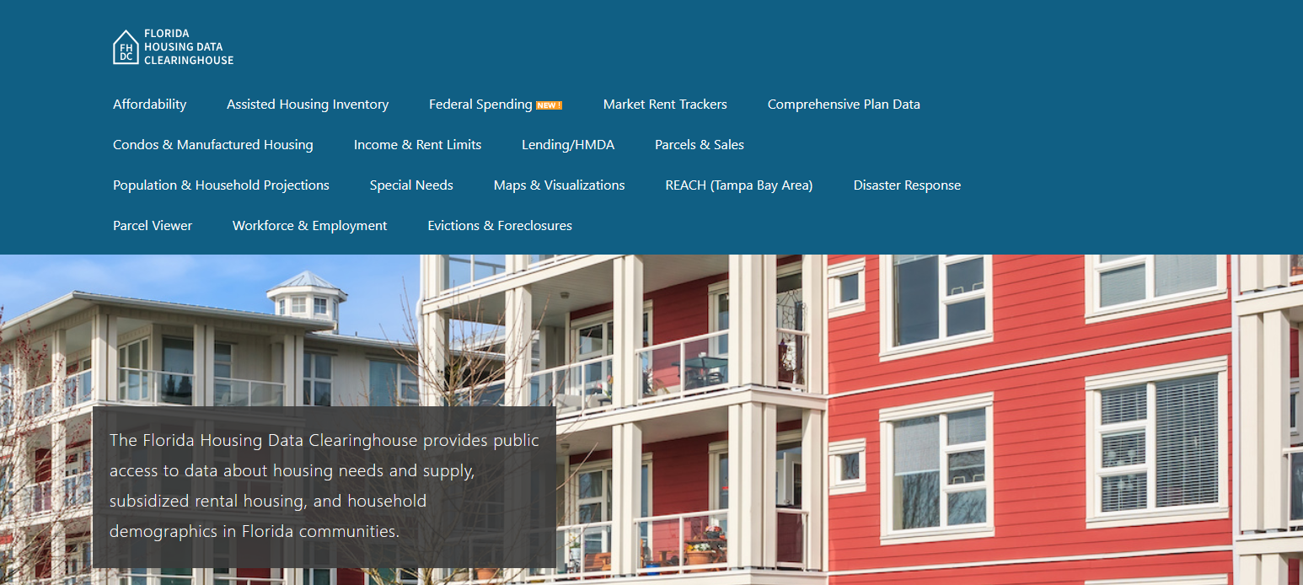

Volusia County Housing Trends
Shimberg Center for Housing Studies
October 2025

Slide 2
Changes in Volusia County’s home prices closely mirror statewide trends.
Florida
Volusia County
Median Single Family Home Sale Price, Volusia County & Florida, 2004-2024 (2024 $)
Source: Shimberg Center analysis of Florida Department of Revenue, Sales Data Files. All values in 2024 dollars to correct for inflation.

Slide 3
Affordable Housing Terminology
  Housing is usually considered to be affordable if it costs no more than 30% of household income.
  Cost burdened: Paying more than 30% of income for owner or renter costs
  Severely cost burdened: Paying more than 50% of income
  Area median income (AMI): Used to create standard income measures across places and household sizes, expressed as % AMI

Slide 4
2025 Volusia County Income (% AMI) and Housing Cost Limits
Income level | Annual income range (1-4 person household) | Hourly wage, 1 full-time job | Hourly wage, 2 full-time jobs | Max. affordable monthly housing cost (1-3 bedroom unit)
50% AMI | $31,650-$45,200 | $15-$22 | - | $848-$1,175
80% AMI | $50,640-$72,320 | $24-$35 | $14 | $1,357-$1,881
120% AMI | $75,960-$108,480 | $37-$52 | $21-$26 | $2,035-$2,821
http://flhousingdata.shimberg.ufl.edu/income-and-rent-limits

Slide 5
Very low-income owners make up the largest group of cost-burdened households in Volusia County.
Cost Burdened Households by Income as a Percentage of Area Median Income (AMI), Volusia County, 2023
Source: Shimberg Center tabulation of U.S. Census Bureau, 2023 American Community Survey. Student-headed, non-family households excluded.

Slide 6
Housing costs outpace wages for many occupations.
Deltona-Daytona Beach-Ormond Beach area housing wage: $33.04/hour
A full-time worker would need to earn this amount to rent a typical 2BR apartment (HUD Fair Market Rent 2025: $1,718/mo).
Median wage for Deltona-Daytona Beach-Ormond Beach area: $20.62/hour. A full-time, year-round worker with this wage can afford $1,072 in rent.
Sources: National Low Income Housing Coalition, Out of Reach; Shimberg Center tabulation of Florida Department of Economic Opportunity, Occupational Employment and Wage Statistics

Slide 7
How much can workers afford to pay for housing each month?
$600-799
$800-999
$1,000-1,200
Median, all occupations
Retail Salesperson
Stocker
Fast Food Worker
Waiter
Cashier
Bartender
Housekeeper
Dining Attendant
Restaurant Host
Dishwasher
Hand Packer
Cook
Customer Service Rep
Nursing Asst
Janitor
Landscaper
Food Prep Supervisor
Laborer
Personal Care Aide
Medical Secretary
Office Clerk
Maintenance Worker
Retail Supervisor
Secretary
Bookkeeper
General Fabricator
Carpenter
Equipment Operator
Billing Clerk
Source: Shimberg Center tabulation of Florida Department of Economic Security, Occupational Employment Statistics and Wages. Based on median wage for occupations in Volusia County. Assumes full-time worker, 30% of income spent on housing costs.

Slide 8
Evictions & foreclosures fell sharply in Q2 2020 during the state moratorium, then increased when filings were permitted again.
Evictions
Foreclosures
Eviction & Foreclosure Filings, Volusia County
Source: Shimberg Center tabulation of filing data from Florida Clerks & Comptrollers and Office of the State Courts Administrator.
Notes:
Foreclosures
Evictions

Slide 9
Building a Local Housing System: The Affordable Housing Continuum
Supportive Housing (affordable units + services)
Homeless
Affordable rental housing
Public housing
Subsidized (Florida Housing, HUD, USDA)
Affordable home ownership
Shared equity (e.g. community land trust)
Down payment assistance
Older adults
People with disabilities
Other special needs
NOAH (Naturally Occurring Affordable Housing)
Low-interest loans
Affordable construction
Home rehab and weatherization
Vouchers

Slide 10
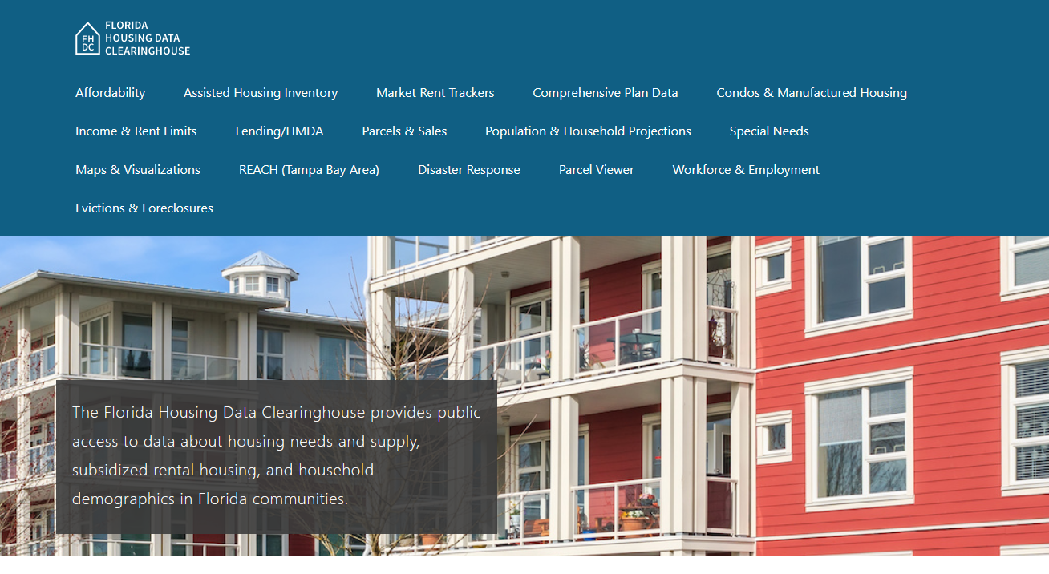
Contact
Shimberg Center for Housing Studies
352-273-1192
Main site: http://www.shimberg.ufl.edu
Data clearinghouse: http://flhousing.data.shimberg.ufl.edu

