Slide 1
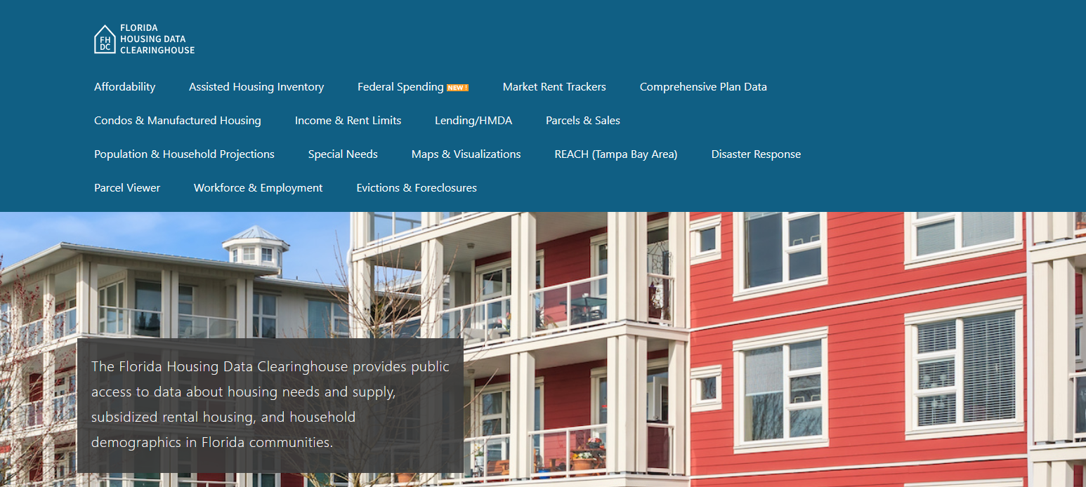

Sumter County Housing Trends
Shimberg Center for Housing Studies
October 2025

Slide 2
Sumter County home prices historically have been less volatile than statewide prices but have risen recently.
Florida
Sumter County
Median Single Family Home Sale Price, Sumter County & Florida, 2004-2024 (2024 $)
Source: Shimberg Center analysis of Florida Department of Revenue, Sales Data Files. All values in 2024 dollars to correct for inflation.

Slide 3
Affordable Housing Terminology
  Housing is usually considered to be affordable if it costs no more than 30% of household income.
  Cost burdened: Paying more than 30% of income for owner or renter costs
  Severely cost burdened: Paying more than 50% of income
  Area median income (AMI): Used to create standard income measures across places and household sizes, expressed as % AMI

Slide 4
2025 Sumter County Income (% AMI) and Housing Cost Limits
Income level | Annual income range (1-4 person household) | Hourly wage, 1 full-time job | Hourly wage, 2 full-time jobs | Max. affordable monthly housing cost (1-3 bedroom unit)
50% AMI | $33,450-$47,800 | $16-$23 | - | $896-$1,243
80% AMI | $53,520-$76,480 | $26-$37 | $15-$19 | $1,434-$1,989
120% AMI | $80,280-$114,720 | $39-$55 | $22-$28 | $2,151-$2,983
http://flhousingdata.shimberg.ufl.edu/income-and-rent-limits

Slide 5
Very low-income owners make up the largest group of cost-burdened households in Sumter County.
Cost Burdened Households by Income as a Percentage of Area Median Income (AMI), Sumter County, 2023
Source: Shimberg Center tabulation of U.S. Census Bureau, 2023 American Community Survey. Student-headed, non-family households excluded.

Slide 6
Housing costs outpace wages for many occupations.
Sumter County housing wage: $21.02/hour
A full-time worker would need to earn this amount to rent a typical 2BR apartment (HUD Fair Market Rent 2023: $1,093/mo).
Median wage for Sumter County, 2023: $22.04/hour. A full-time, year-round worker with this wage can afford $1,146 in rent.
Sources: National Low Income Housing Coalition, Out of Reach; Shimberg Center tabulation of Florida Department of Economic Opportunity, Occupational Employment and Wage Statistics

Slide 7
How much can workers afford to pay for housing each month?
$600-799
$800-999
$1,000-1,200
Median, all occupations
Retail Salesperson
Stocker
Waiter
Cashier
Fast Food Worker
Housekeeper
Restaurant Host
Hand Packer
Bartender
Dishwasher
Dining Attendant
Cook
Landscaper
Customer Service Rep
Medical Secretary
Personal Care Aide
Nursing Asst
Food Prep Worker
Janitor
Receptionist
Heavy Truck Driver
Office Clerk
Construction Laborer
Medical Asst
Maintenance Worker
Bookkeeper
Food Prep Supervisor
Equipment Operator
Secretary
Source: Shimberg Center tabulation of Florida Department of Economic Security, Occupational Employment Statistics and Wages. Based on median wage for occupations in Sumter County. Assumes full-time worker, 30% of income spent on housing costs.

Slide 8
Evictions & foreclosures fell in Q2 2020 during the state moratorium, then increased when filings were permitted again.
Evictions
Foreclosures
Eviction & Foreclosure Filings, Sumter County
Source: Shimberg Center tabulation of filing data from Florida Clerks & Comptrollers and Office of the State Courts Administrator.
Notes:
Foreclosures
Evictions

Slide 9
Building a Local Housing System: The Affordable Housing Continuum
Supportive Housing (affordable units + services)
Homeless
Affordable rental housing
Public housing
Subsidized (Florida Housing, HUD, USDA)
Affordable home ownership
Shared equity (e.g. community land trust)
Down payment assistance
Older adults
People with disabilities
Other special needs
NOAH (Naturally Occurring Affordable Housing)
Low-interest loans
Affordable construction
Home rehab and weatherization
Vouchers

Slide 10
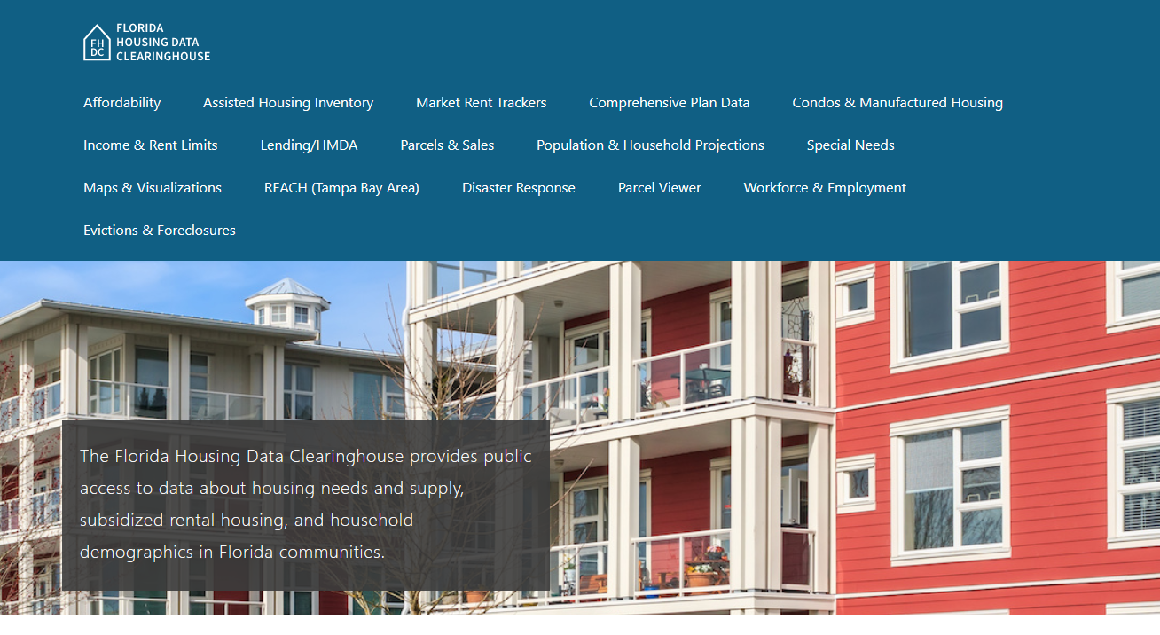
Contact
Shimberg Center for Housing Studies
352-273-1192
Main site: http://www.shimberg.ufl.edu
Data clearinghouse: http://flhousing.data.shimberg.ufl.edu

