Slide 1
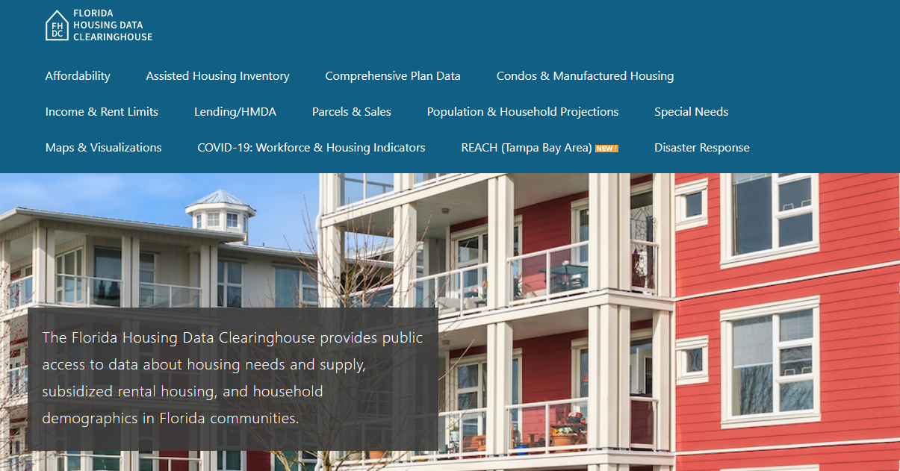
Santa Rosa County Housing Trends
Shimberg Center for Housing Studies
June 2024

Slide 2
Santa Rosa County’s median home price remained relatively steady during the statewide housing crash. The county median has been rising in recent years.
Florida
Santa Rosa County
Median Single Family Home Sale Price, Polk County & Florida, 2003-2023 (2023$)
Source: Shimberg Center analysis of Florida Department of Revenue, Sales Data Files. All values in 2023 dollars to correct for inflation.

Slide 3
Affordable Housing Terminology
Housing is usually considered to be affordable if it costs no more than 30% of household income.
Cost burdened: Paying more than 30% of income for owner or renter costs
Severely cost burdened: Paying more than 50% of income
Area median income (AMI): Used to create standard income measures across places and household sizes, expressed as % AMI

Slide 4
Example: 2024 Santa Rosa County Income (% AMI) and Housing Cost Limits
Income level | Annual income range (1-4 person household) | Hourly wage, 1 full-time job | Hourly wage, 2 full-time jobs | Max. affordable monthly housing cost (1-3 bedroom unit)
50% AMI | $31,500-$44,950 | $15-$22 | - | $843-$1,168
80% AMI | $50,400-$71,920 | $24-$35 | $14-$18 | $1,350-$1,870
120% AMI | $75,600-$107,880 | $36-$52 | $21-$26 | $2,025-$2,805
http://flhousingdata.shimberg.ufl.edu/income-and-rent-limits

Slide 5
Low and very low-income homeowners make up the largest group of cost-burdened households in Santa Rosa County.
Cost Burdened Households by Income as a Percentage of Area Median Income (AMI), Santa Rosa County, 2022
Source: Shimberg Center tabulation of U.S. Census Bureau, 2022 American Community Survey
Note: Red/Underlined numbers indicate values that are not statistically significant.

Slide 6
Housing costs outpace wages for many occupations.
Santa Rosa County housing wage: $22.46/hour
A full-time worker would need to earn this amount to rent a typical 2BR apartment (HUD Fair Market Rent 2023: $1,168/mo).
Median wage for Santa Rosa County, 2023: $19.54/hour. A full-time, year-round worker with this wage can afford $1,016 in rent.
Sources: National Low Income Housing Coalition, Out of Reach; Shimberg Center tabulation of Florida Department of Economic Opportunity, Occupational Employment and Wage Statistics

Slide 7
How much can workers afford to pay for housing each month?
$600-799
$800-999
$1,000-1,200
Auto Techs and Mechanics
Child, Family, and School Social Workers
Bartenders
Bus Drivers
Carpenters
Dental Assistants
Heavy and Tractor-Trailer Truck Drivers
Median, All Occupations
Mental Health and Substance Abuse Social Workers
Paramedics
Roofers
Cashiers
Childcare Workers
Restaurant Cooks
Dishwashers
Fast Food and Counter Workers
Food Preparation Workers
Home Health and Personal Care Aides
Hotel, Motel, and Resort Desk Clerks
Janitors and Cleaners
Laundry and Dry-Cleaning Workers
Maids and Housekeeping Cleaners
Nursing Assistants
Preschool Teachers
Receptionists
Retail Salespersons
Security Guards
Substitute Teachers
Waitstaff
Construction Laborers
Customer Service Reps
Firefighters
Hairdressers
Landscaping and Groundskeeping Workers
Light Truck Drivers
Medical Assistants
Office Clerks
Painters
Pharmacy Techs
Secretaries and Administrative Assistants
Tellers
Veterinary Techs
Source: Shimberg Center tabulation of Florida Department of Economic Security, Occupational Employment Statistics and Wages. Based on median wage for occupations in Santa Rosa County. Assumes full-time worker, 30% of income spent on housing costs.

Slide 8
Eviction & foreclosure filings fell sharply in Q2 2020 during state moratorium, then increased when filings were permitted again. Filings are still below pre-pandemic levels.
Eviction & Foreclosure Filings, Santa Rosa County
Source: Shimberg Center tabulation of filing data from Florida Clerks & Comptrollers and Office of the State Courts Administrator.

Slide 9
Building a Local Housing System: The Affordable Housing Continuum
Supportive Housing (affordable units + services)
Homeless
Affordable rental housing
Public housing
Subsidized (Florida Housing, HUD, USDA)
Affordable home ownership
Shared equity (e.g. community land trust)
Down payment assistance
Older adults
People with disabilities
Other special needs
NOAH (Naturally Occurring Affordable Housing)
Low-interest loans
Affordable construction
Home rehab and weatherization
Vouchers

Slide 10
Contact
Shimberg Center for Housing Studies
352-273-1192
aray@ufl.edu
Main site: http://www.shimberg.ufl.edu
Data clearinghouse: http://flhousing.data.shimberg.ufl.edu

