Slide 1
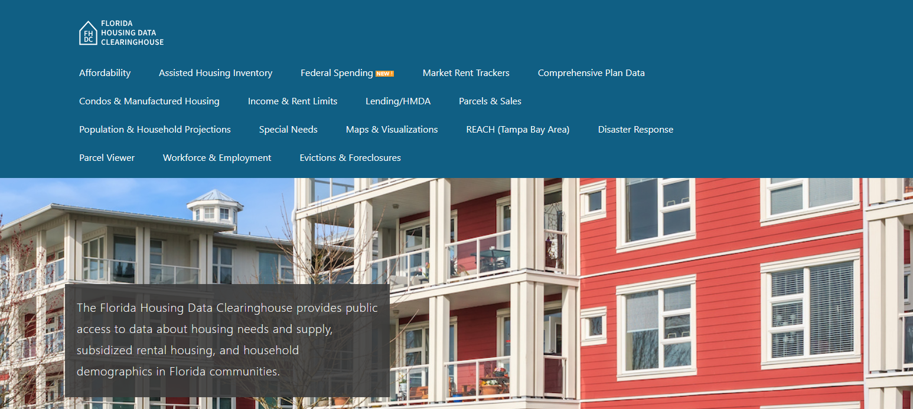

Santa Rosa County Housing Trends
Shimberg Center for Housing Studies
October 2025

Slide 2
Recent changes in Santa Rosa County’s home prices closely mirror statewide trends.
Florida
Santa Rosa County
Median Single Family Home Sale Price, Santa Rosa County & Florida, 2004-2024 (2024 $)
Source: Shimberg Center analysis of Florida Department of Revenue, Sales Data Files. All values in 2024 dollars to correct for inflation.

Slide 3
Affordable Housing Terminology
Housing is usually considered to be affordable if it costs no more than 30% of household income.
Cost burdened: Paying more than 30% of income for owner or renter costs
Severely cost burdened: Paying more than 50% of income
Area median income (AMI): Used to create standard income measures across places and household sizes, expressed as % AMI

Slide 4
2025 Santa Rosa County Income (% AMI) and Housing Cost Limits
Income level | Annual income range (1-4 person household) | Hourly wage, 1 full-time job | Hourly wage, 2 full-time jobs | Max. affordable monthly housing cost (1-3 bedroom unit)
50% AMI | $34,350-$49,050 | $17-$24 | - | $920-$1,275
80% AMI | $54,960-$78,480 | $26-$38 | $15-$19 | $1,472-$2,041
120% AMI | $82,440-$117,720 | $40-$57 | $23-$29 | $2,208-$3,061
http://flhousingdata.shimberg.ufl.edu/income-and-rent-limits

Slide 5
Very low-income owners make up the largest group of cost-burdened households in Santa Rosa County.
Cost Burdened Households by Income as a Percentage of Area Median Income (AMI), Santa Rosa County, 2023
Source: Shimberg Center tabulation of U.S. Census Bureau, 2023 American Community Survey. Student-headed, non-family households excluded.

Slide 6
Housing costs outpace wages for many occupations.
Pensacola-Ferry Pass-Brent MSA housing wage: $30.87/hour
A full-time worker would need to earn this amount to rent a typical 2BR apartment (HUD Fair Market Rent 2025: $1,605/mo).
Median wage for Pensacola-Ferry Pass-Brent MSA: $22.22/hour. A full-time, year-round worker with this wage can afford $1,156 in rent.
Sources: National Low Income Housing Coalition, Out of Reach; Shimberg Center tabulation of Florida Department of Economic Opportunity, Occupational Employment and Wage Statistics

Slide 7
How much can workers afford to pay for housing each month?
$600-799
$800-999
$1,000-1,200
Median, all occupations
Fast Food Worker
Stocker
Retail Salesperson
Cashier
Waiter
Janitor
Personal Care Aide
Housekeeper
Bartender
Dining Attendant
Restaurant Host
Office Clerk
Cook
Laborer
Nursing Asst
Food Prep Supervisor
Medical Asst
Medical Secretary
Food Prep Worker
Landscaper
Customer Service Rep
Maintenance Worker
Bookkeeper
Secretary
Construction Laborer
Retail Supervisor
Financial Agent
Light Truck Driver
Auto Technician
Source: Shimberg Center tabulation of Florida Department of Economic Security, Occupational Employment Statistics and Wages. Based on median wage for occupations in Santa Rosa County. Assumes full-time worker, 30% of income spent on housing costs.

Slide 8
Evictions & foreclosures fell sharply in Q2 2020 during the state moratorium, then increased when filings were permitted again.
Foreclosures
Evictions
Eviction & Foreclosure Filings, Santa Rosa County
Source: Shimberg Center tabulation of filing data from Florida Clerks & Comptrollers and Office of the State Courts Administrator.
Notes:
Foreclosures
Evictions

Slide 9
Building a Local Housing System: The Affordable Housing Continuum
Supportive Housing (affordable units + services)
Homeless
Affordable rental housing
Public housing
Subsidized (Florida Housing, HUD, USDA)
Affordable home ownership
Shared equity (e.g. community land trust)
Down payment assistance
Older adults
People with disabilities
Other special needs
NOAH (Naturally Occurring Affordable Housing)
Low-interest loans
Affordable construction
Home rehab and weatherization
Vouchers

Slide 10
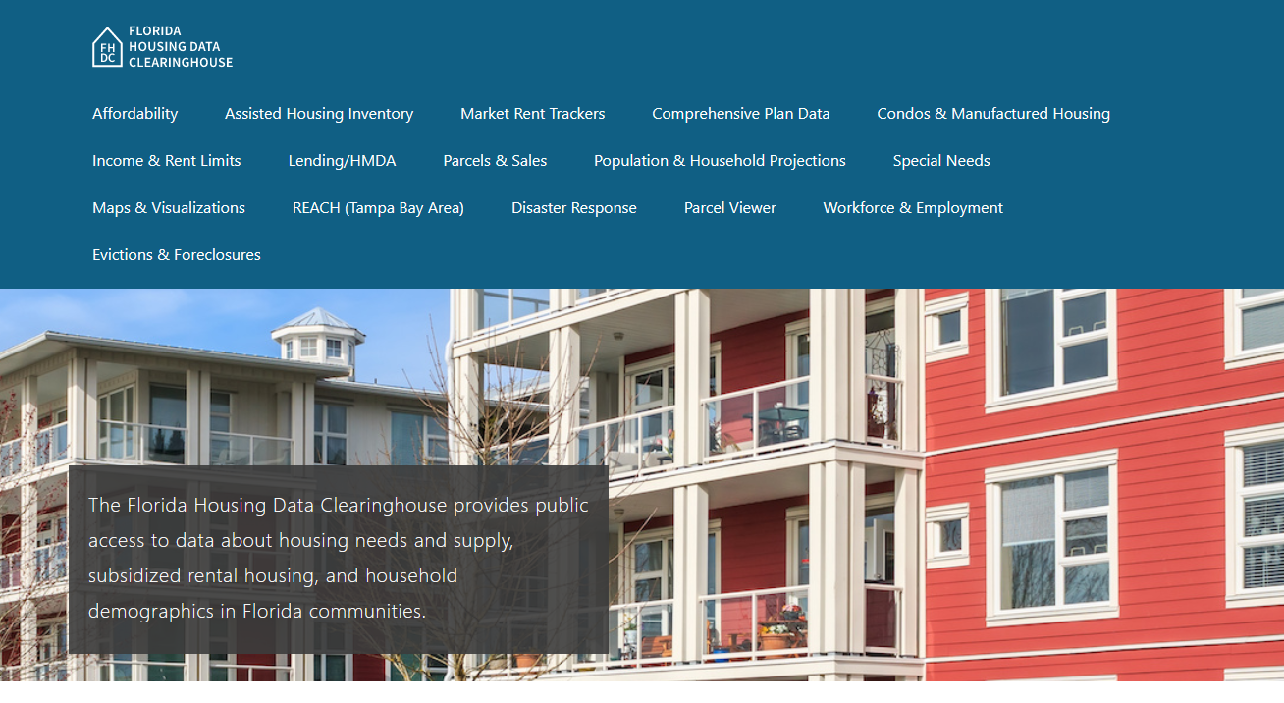
Contact
Shimberg Center for Housing Studies
352-273-1192
Main site: http://www.shimberg.ufl.edu
Data clearinghouse: http://flhousing.data.shimberg.ufl.edu

