Slide 1
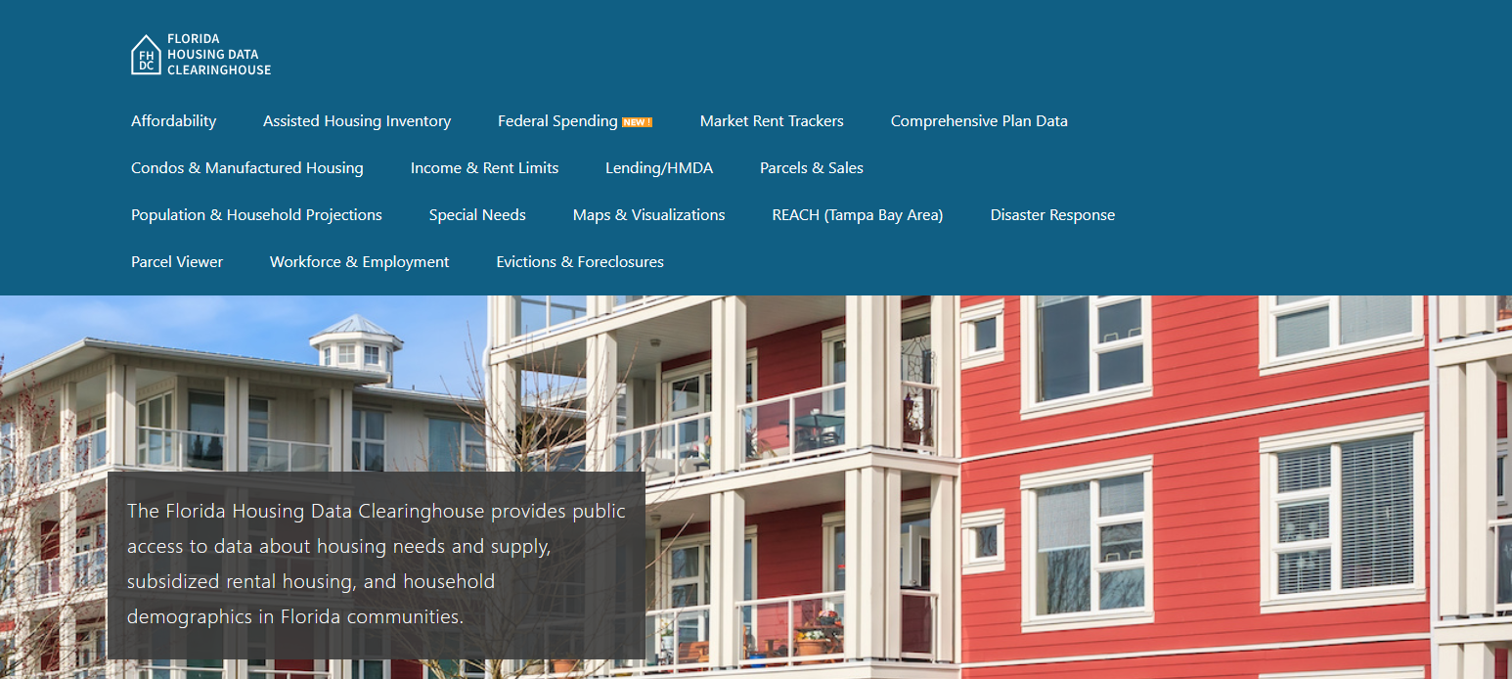

Miami-Dade County Housing Trends
Shimberg Center for Housing Studies
October 2025

Slide 2
Home prices in Miami-Dade County consistently exceed statewide prices.
Miami-Dade County
Florida
Median Single Family Home Sale Price, Miami-Dade County & Florida, 2004-2024 (2024 $)
Source: Shimberg Center analysis of Florida Department of Revenue, Sales Data Files. All values in 2024 dollars to correct for inflation.

Slide 3
Units renting for $1,200 or less (2023 $) dropped sharply between 2013 and 2023.
Net change 2013-2023: +59,467 rental units
$1,200+ units grew by over 113,000
Units at or below $1,200 fell by over 54,000
Units by Gross Rent Above/Below $1,200 (2023 $), Miami-Dade and Monroe Counties, 2013 & 2023
Source: Shimberg Center tabulation of U.S. Census Bureau, 2013 and 2023 American Community Survey. Year 2013 rents adjusted to 2023 dollars using Consumer Price Index. Student-headed, non-family occupied units excluded.

Slide 4
Affordable Housing Terminology
Housing is usually considered to be affordable if it costs no more than 30% of household income.
Cost burdened: Paying more than 30% of income for owner or renter costs
Severely cost burdened: Paying more than 50% of income
Area median income (AMI): Used to create standard income measures across places and household sizes, expressed as % AMI

Slide 5
2025 Miami-Dade County Income (% AMI) and Housing Cost Limits
Income level | Annual income range (1-4 person household) | Hourly wage, 1 full-time job | Hourly wage, 2 full-time jobs | Max. affordable monthly housing cost (1-3 bedroom unit)
50% AMI | $43,400-$61,950 | $21-$30 | - | $1,161-$1,611
80% AMI | $69,440-$99,120 | $33-$48 | $19-$24 | $1,859-$2,578
120% AMI | $104,160-$148,680 | $50-$71 | $29-$36 | $2,788-$3,867
http://flhousingdata.shimberg.ufl.edu/income-and-rent-limits

Slide 6
Very low-income renters make up the largest group of cost-burdened households in Miami-Dade County.
Cost Burdened Households by Income as a Percentage of Area Median Income (AMI), Miami-Dade and Monroe Counties, 2023
Source: Shimberg Center tabulation of U.S. Census Bureau, 2023 American Community Survey. Student-headed, non-family households excluded.

Slide 7
Housing costs outpace wages for many occupations.
Miami-Miami Beach-Kendall area housing wage: $44.79/hour
A full-time worker would need to earn this amount to rent a typical 2BR apartment (HUD Fair Market Rent 2025: $2,329/mo).
Median wage for Miami-Miami Beach-Kendall area: $23.67/hour. A full-time, year-round worker with this wage can afford $1,231 in rent.
Sources: National Low Income Housing Coalition, Out of Reach; Shimberg Center tabulation of Florida Department of Economic Opportunity, Occupational Employment and Wage Statistics

Slide 8
How much can workers afford to pay for housing each month?
$600-799
$800-999
$1,000-1,200
Office Clerk
Fast Food Worker
Retail Salesperson
Waiter
Cashier
Janitor
Bartender
Dishwasher
Restaurant Host
Hand Packer
Parking Attendant
Attendant
Customer Service Rep
Stocker
Laborer
Security Guard
Cook
Personal Care Aide
Receptionist
Nursing Asst
Landscaper
Maintenance Worker
Secretary
Medical Secretary
Food Prep Supervisor
Light Truck Driver
Medical Asst
Inventory Clerk
Construction Laborer
Pharmacy Tech
Source: Shimberg Center tabulation of Florida Department of Economic Security, Occupational Employment Statistics and Wages. Based on median wage for occupations in Miami-Dade County. Assumes full-time worker, 30% of income spent on housing costs.

Slide 9
Evictions & foreclosures fell sharply in Q2 2020 during the state moratorium, then increased when filings were permitted again.
Evictions
Foreclosures
Eviction & Foreclosure Filings, Miami-Dade County
Source: Shimberg Center tabulation of filing data from Florida Clerks & Comptrollers and Office of the State Courts Administrator.
Notes:
Foreclosures
Evictions

Slide 10
Building a Local Housing System: The Affordable Housing Continuum
Supportive Housing (affordable units + services)
Homeless
Affordable rental housing
Public housing
Subsidized (Florida Housing, HUD, USDA)
Affordable home ownership
Shared equity (e.g. community land trust)
Down payment assistance
Older adults
People with disabilities
Other special needs
NOAH (Naturally Occurring Affordable Housing)
Low-interest loans
Affordable construction
Home rehab and weatherization
Vouchers

Slide 11
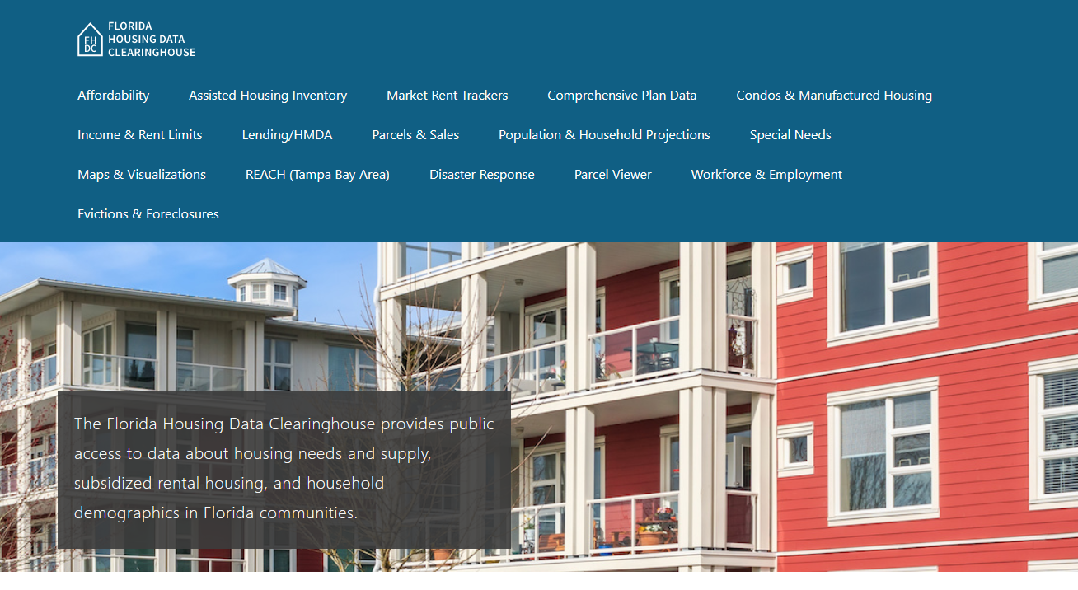
Contact
Shimberg Center for Housing Studies
352-273-1192
Main site: http://www.shimberg.ufl.edu
Data clearinghouse: http://flhousing.data.shimberg.ufl.edu
Notes:
No changes

