Slide 1
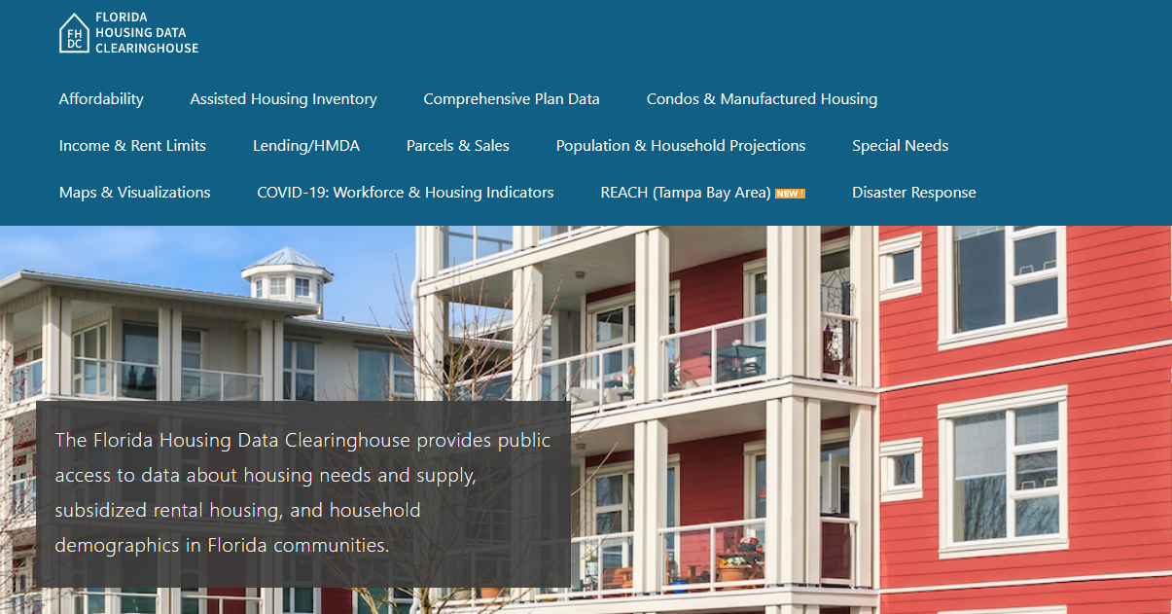
Leon County Housing Trends
Shimberg Center for Housing Studies
June 2024

Slide 2
Leon County home prices have been much more stable than statewide prices.
Florida
Leon County
Median Single Family Home Sale Price, Florida, Leon County, and Tallahassee, 2003-2023 (2023$)
Source: Shimberg Center analysis of Florida Department of Revenue, Sales Data Files. All values in 2023 dollars to correct for inflation.

Slide 3
Affordable Housing Terminology
Housing is usually considered to be affordable if it costs no more than 30% of household income.
Cost burdened: Paying more than 30% of income for owner or renter costs
Severely cost burdened: Paying more than 50% of income
Area median income (AMI): Used to create standard income measures across places and household sizes, expressed as % AMI

Slide 4
2024 Tallahassee Metro Area Income (% AMI) & Housing Cost Limits
Income level | Annual income range (1-4 person household) | Hourly wage, 1 full-time job | Hourly wage, 2 full-time jobs | Max. affordable monthly housing cost (1-3 bedroom unit)
50% AMI | $31,050-$44,350 | $15-$21 | - | $831-$1,153
80% AMI | $49,680-$70,960 | $24-$34 | $14-$17 | $1,331-$1,845
120% AMI | $74,520-$106,440 | $36-$51 | $21-$26 | $1,996-$2,767
http://flhousingdata.shimberg.ufl.edu/income-and-rent-limits

Slide 5
Very low-income renters make up the largest group of cost-burdened households (paying more than 30% of income for housing), even excluding student renters.
Households by Tenure, Income (% AMI), and Cost Burden, Leon County, 2021
Notes: “Student-headed” refers to non-family renter households headed by a full-time student. Counts of owner households headed by students are not statistically significantly different from zero.
Source: Shimberg Center tabulation of U.S. Census Bureau, 2021 American Community Survey

Slide 6
Housing costs outpace wages for many occupations.
Leon County housing wage: $22.62/hour
A full-time worker would need to earn this amount to rent a typical 2BR apartment (HUD Fair Market Rent 2023: $1,176/mo).
Median wage for Leon County, 2023: $19.92/hour. A full-time, year-round worker with this wage can afford $1,036 in rent.
Sources: National Low Income Housing Coalition, Out of Reach; Shimberg Center tabulation of Florida Department of Economic Opportunity, Occupational Employment and Wage Statistics

Slide 7
How much can workers afford to pay for housing each month?
$600-799
$800-999
$1,000-1,200
Carpenters
Auto Techs & Mechanics
Bartenders
Child, Family, & School Social Workers
Correctional Officers
Electricians
Firefighters
HVAC & Refrigeration Mechanics
Heavy & Tractor-Trailer Truck Drivers
Median, All Occupations
Cashiers
Childcare Workers
Restaurant Cooks
Customer Service Reps
Farmworkers
Food Preparation Workers
Hairdressers
Home Health & Personal Care Aides
Hotel, Motel, & Resort Desk Clerks
Janitors & Cleaners
Landscaping Workers
Maids & Housekeeping Cleaners
Nursing Assistants
Preschool Teachers
Receptionists
Retail Salespersons
Security Guards
Substitute Teachers
Waitstaff
Bus Drivers
Construction Laborers
Dental Assistants
Light Truck Drivers
Medical Assistants
Mental Health & Substance Abuse Social Workers
Office Clerks
Painters
Pharmacy Techs
Roofers
Secretaries & Administrative Assistants
Tellers
Veterinary Techs
Fast Food & Counter Workers (<$600)
Source: Shimberg Center tabulation of Florida Department of Economic Security, Occupational Employment Statistics & Wages. Based on median wage for occupations in Leon County. Assumes full-time worker, 30% of income spent on housing costs.

Slide 8
Eviction & foreclosure fell sharply in Q2 2020 during the state moratorium, then increased when filings were permitted again. Eviction filings have now risen above pre-pandemic levels, while foreclosure filings remain slightly below pre-pandemic levels.
Eviction & Foreclosure Filings, Leon County
Source: Shimberg Center tabulation of filing data from Florida Clerks & Comptrollers and Office of the State Courts Administrator.

Slide 9
Building a Local Housing System: The Affordable Housing Continuum
Supportive Housing (affordable units + services)
Homeless
Affordable rental housing
Public housing
Subsidized (Florida Housing, HUD, USDA)
Affordable home ownership
Shared equity (e.g. community land trust)
Down payment assistance
Older adults
People with disabilities
Other special needs
NOAH (Naturally Occurring Affordable Housing)
Low-interest loans
Affordable construction
Home rehab and weatherization
Vouchers

Slide 10
Contact
Contact Us
352-273-1192
Main site: http://www.shimberg.ufl.edu
Data clearinghouse: http://flhousing.data.shimberg.ufl.edu

