Slide 1
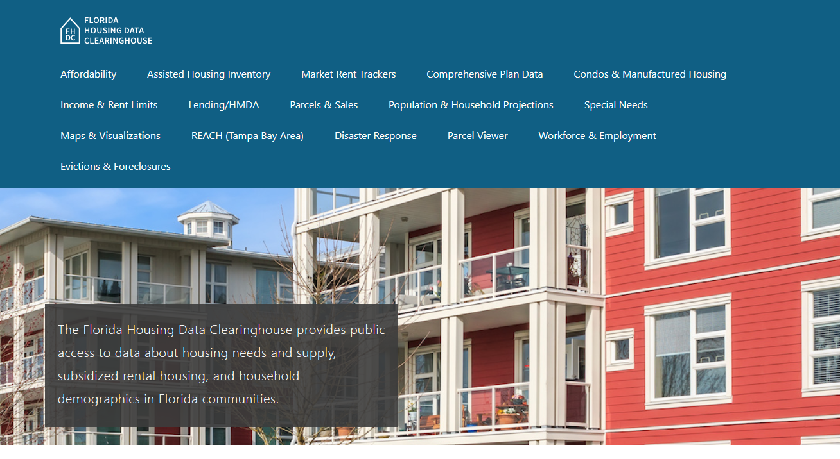
Lee County Housing Trends
Shimberg Center for Housing Studies
June 2024

Slide 2
Lee County home prices have been more volatile than statewide prices during Florida’s boom-and-bust housing cycles.
Lee County
Florida
Median Single Family Home Sale Price, Lee County & Florida, 2003-2023 (2023$)
Source: Shimberg Center analysis of Florida Department of Revenue, Sales Data Files. All values in 2023 dollars to correct for inflation.

Slide 3
Lee County added over 9,400 rental units between 2012 and 2022 but lost units renting for $1,200 or less (2022 $).
Net increase 2012-2021: 9,415 rental units
$1,200+ units grew by over 30,000
Units at or below $1,200 fell by over 21,000
Units by Gross Rent Above/Below $1,200 (2022 $), Lee County, 2012 & 2022
Source: Shimberg Center tabulation of U.S. Census Bureau, 2012 and 2022 American Community Survey. Year 2012 rents adjusted to 2022 dollars using Consumer Price Index.

Slide 4
Affordable Housing Terminology
Housing is usually considered to be affordable if it costs no more than 30% of household income.
Cost burdened: Paying more than 30% of income for owner or renter costs
Severely cost burdened: Paying more than 50% of income
Area median income (AMI): Used to create standard income measures across places and household sizes, expressed as % AMI

Slide 5
Example: 2024 Lee County Income (% AMI) and Housing Cost Limits
Income level | Annual income range (1-4 person household) | Hourly wage, 1 full-time job | Hourly wage, 2 full-time jobs | Max. affordable monthly housing cost (1-3 bedroom unit)
50% AMI | $32,750-$46,800 | $16-$23 | $12 | $877-$1,216
80% AMI | $52,400-$74,880 | $25-$36 | $14-$18 | $1,404-$1,947
120% AMI | $78,600-$112,320 | $38-$54 | $22-$27 | $2,106-$2,920
http://flhousingdata.shimberg.ufl.edu/income-and-rent-limits

Slide 6
Very low-income homeowners make up the largest group of cost-burdened households in Lee County.
Cost Burdened Households by Income as a Percentage of Area Median Income (AMI), Lee County, 2022
Source: Shimberg Center tabulation of U.S. Census Bureau, 2022 American Community Survey

Slide 7
Housing costs outpace wages for many occupations.
Lee County housing wage: $27.90/hour
A full-time worker would need to earn this amount to rent a typical 2BR apartment (HUD Fair Market Rent 2023: $1,451/mo).
Median wage for Lee County, 2023: $19.78/hour. A full-time, year-round worker with this wage can afford $1,029 in rent.
Sources: National Low Income Housing Coalition, Out of Reach; Shimberg Center tabulation of Florida Department of Economic Opportunity, Occupational Employment and Wage Statistics

Slide 8
How much can workers afford to pay for housing each month?
$600-749
$800-949
$950-1,100
Median, All Occupations
Restaurant Cooks
Bartenders
Cashiers
Childcare Workers
Farmworkers
Fast Food and Counter Workers
Janitors and Cleaners
Laundry and Dry-Cleaning Workers
Waitstaff
Food Preparation Workers
Hairdressers
Landscaping and Groundskeeping Workers
Nursing Assistants
Receptionists
Substitute Teachers
Tellers
Medical Assistants
Painters
Secretaries and Administrative Assistants
Pharmacy Techs
Light Truck Drivers
Office Clerks
Veterinary Techs
Construction Laborers
Customer Service Reps
Maids and Housekeepers
Security Guards
Hotel, Motel, and Resort Desk Clerks
Retail Salespersons
Home Health and Personal Care Aides
Preschool Teachers
Source: Shimberg Center tabulation of Florida Department of Economic Security, Occupational Employment Statistics and Wages. Based on median wage for occupations in Lee County. Assumes full-time worker, 30% of income spent on housing costs.

Slide 9
Eviction & foreclosure fell sharply in Q2 2020 during the state moratorium, then increased when filings were permitted again. Eviction filings have now risen above pre-pandemic levels, while foreclosure filings are near pre-pandemic levels.
Eviction & Foreclosure Filings, Lee County
Source: Shimberg Center tabulation of filing data from Florida Clerks & Comptrollers and Office of the State Courts Administrator.

Slide 10
Building a Local Housing System: The Affordable Housing Continuum
Supportive Housing (affordable units + services)
Homeless
Affordable rental housing
Public housing
Subsidized (Florida Housing, HUD, USDA)
Affordable home ownership
Shared equity (e.g. community land trust)
Down payment assistance
Older adults
People with disabilities
Other special needs
NOAH (Naturally Occurring Affordable Housing)
Low-interest loans
Affordable construction
Home rehab and weatherization
Vouchers

Slide 11
Contact
Shimberg Center for Housing Studies
352-273-1192
Main site: http://www.shimberg.ufl.edu
Data clearinghouse: http://flhousing.data.shimberg.ufl.edu

