Slide 1
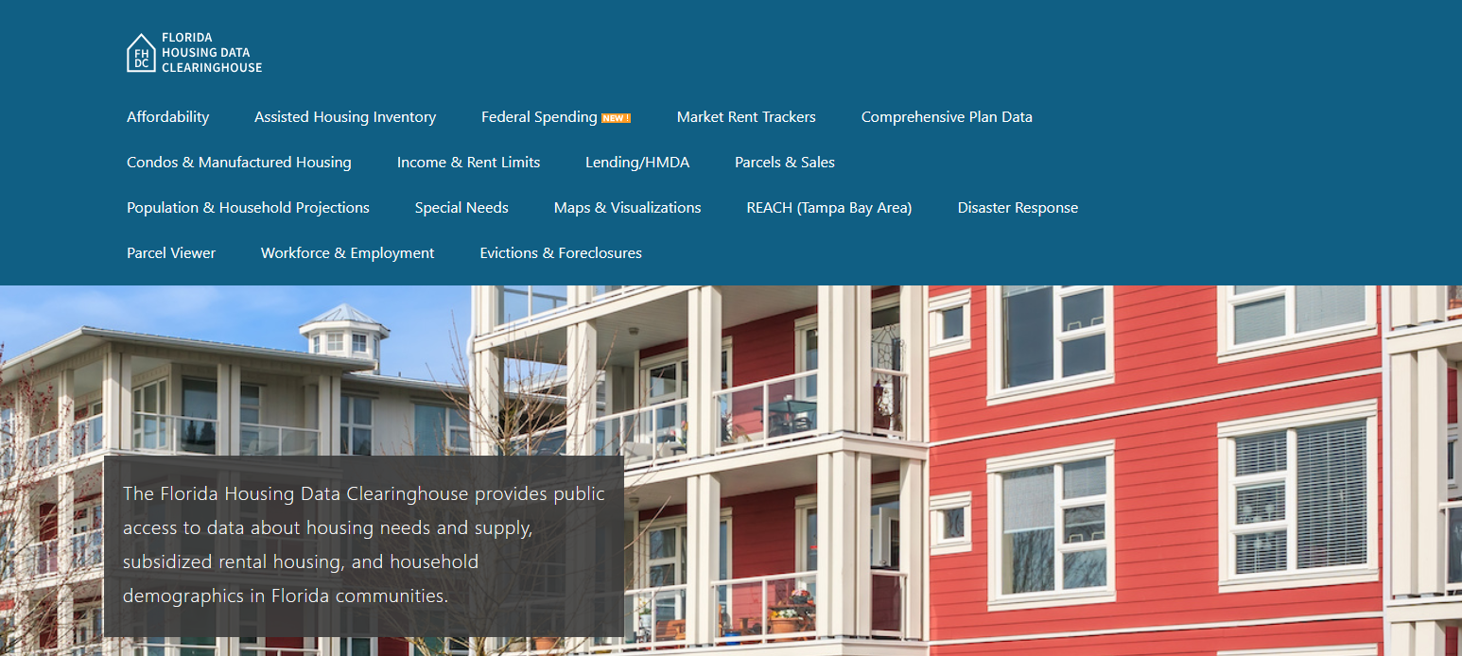

Indian River County Housing Trends
Shimberg Center for Housing Studies
October 2025

Slide 2
Changes in Indian River County’s home prices closely mirror statewide trends.
Indian River County
Florida
Median Single Family Home Sale Price, Indian River County & Florida, 2004-2024 (2024 $)
Source: Shimberg Center analysis of Florida Department of Revenue, Sales Data Files. All values in 2024 dollars to correct for inflation.

Slide 3
Units renting for $1,200 or less (2023 $) dropped sharply between 2013 and 2023.
Net change 2013-2023: -1,268 rental units
$1,200+ units grew by almost 2,800
Units at or below $1,200 fell by over 4,000
Units by Gross Rent Above/Below $1,200 (2023 $), Indian River County, 2013 & 2023
Source: Shimberg Center tabulation of U.S. Census Bureau, 2013 and 2023 American Community Survey. Year 2013 rents adjusted to 2023 dollars using Consumer Price Index. Student-headed, non-family occupied units excluded.

Slide 4
Affordable Housing Terminology
  Housing is usually considered to be affordable if it costs no more than 30% of household income.
  Cost burdened: Paying more than 30% of income for owner or renter costs
  Severely cost burdened: Paying more than 50% of income
  Area median income (AMI): Used to create standard income measures across places and household sizes, expressed as % AMI

Slide 5
2025 Indian River County Income (% AMI) and Housing Cost Limits
Income level | Annual income range (1-4 person household) | Hourly wage, 1 full-time job | Hourly wage, 2 full-time jobs | Max. affordable monthly housing cost (1-3 bedroom unit)
50% AMI | $32,550-$46,500 | $16-$22 | - | $871-$1,209
80% AMI | $52,080-$74,400 | $25-$36 | $14-$18 | $1,395-$1,935
120% AMI | $78,120-$111,600 | $38-$54 | $22-$27 | $2,092-$2,902
http://flhousingdata.shimberg.ufl.edu/income-and-rent-limits

Slide 6
Very low-income owners make up the largest group of cost-burdened households in Indian River County.
Cost Burdened Households by Income as a Percentage of Area Median Income (AMI), Indian River County, 2023
Source: Shimberg Center tabulation of U.S. Census Bureau, 2023 American Community Survey. Student-headed, non-family households excluded.

Slide 7
Housing costs outpace wages for many occupations.
Sebastian-Vero Beach MSA housing wage: $30.13/hour
A full-time worker would need to earn this amount to rent a typical 2BR apartment (HUD Fair Market Rent 2025: $1,567/mo).
Median wage for Sebastian-Vero Beach MSA: $21.34/hour. A full-time, year-round worker with this wage can afford $1,110 in rent.
Sources: National Low Income Housing Coalition, Out of Reach; Shimberg Center tabulation of Florida Department of Economic Opportunity, Occupational Employment and Wage Statistics

Slide 8
How much can workers afford to pay for housing each month?
$600-799
$800-999
$1,000-1,200
Median, all occupations
Retail Salesperson
Stocker
Waiter
Cashier
Fast Food Worker
Housekeeper
Dining Attendant
Hand Packer
Bartender
Attendant
Dishwasher
Landscaper
Cook
Customer Service Rep
Janitor
Personal Care Aide
Nursing Asst
Receptionist
Food Prep Worker
Laborer
Office Clerk
Maintenance Worker
Secretary
Retail Supervisor
Food Prep Supervisor
Roofer
Construction Laborer
Light Truck Driver
Inventory Clerk
Billing Clerk
Source: Shimberg Center tabulation of Florida Department of Economic Security, Occupational Employment Statistics and Wages. Based on median wage for occupations in Indian River County. Assumes full-time worker, 30% of income spent on housing costs.

Slide 9
Building a Local Housing System: The Affordable Housing Continuum
Supportive Housing (affordable units + services)
Homeless
Affordable rental housing
Public housing
Subsidized (Florida Housing, HUD, USDA)
Affordable home ownership
Shared equity (e.g. community land trust)
Down payment assistance
Older adults
People with disabilities
Other special needs
NOAH (Naturally Occurring Affordable Housing)
Low-interest loans
Affordable construction
Home rehab and weatherization
Vouchers

Slide 10
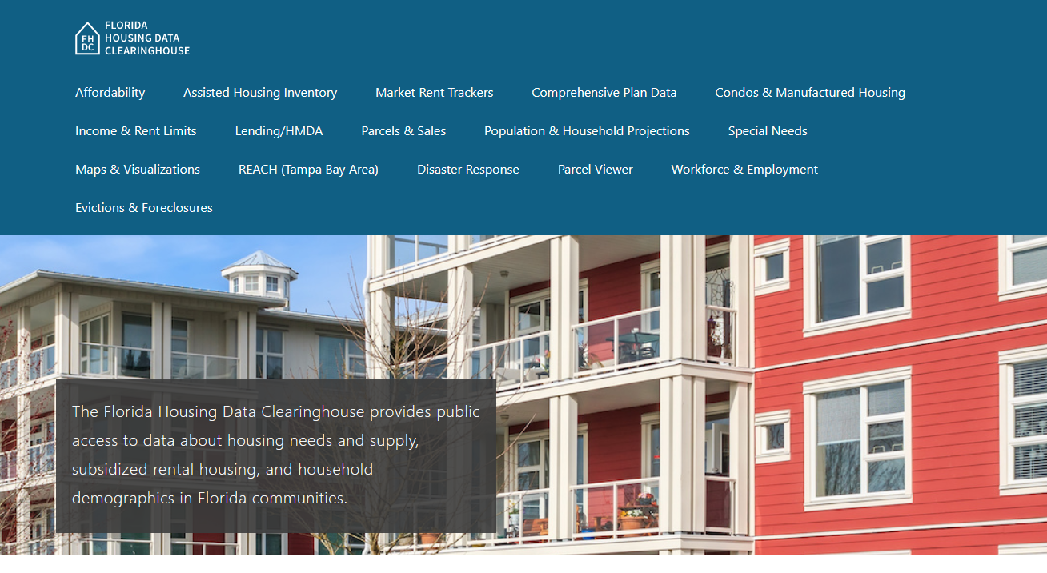
Contact
Shimberg Center for Housing Studies
352-273-1192
Main site: http://www.shimberg.ufl.edu
Data clearinghouse: http://flhousing.data.shimberg.ufl.edu

