Slide 1
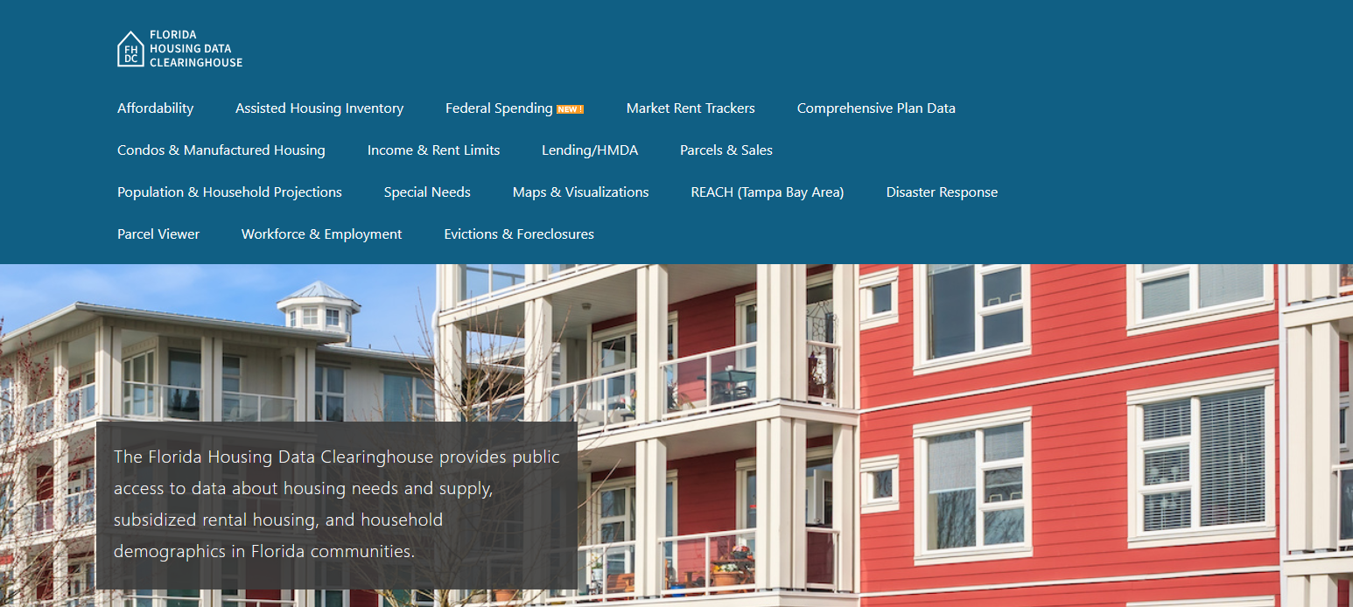

Hillsborough County Housing Trends
Shimberg Center for Housing Studies
October 2025

Slide 2
Changes in Hillsborough County’s home prices closely mirror statewide trends.
Florida
Hillsborough County
Median Single Family Home Sale Price, Hillsborough County & Florida, 2004-2024 (2024 $)
Source: Shimberg Center analysis of Florida Department of Revenue, Sales Data Files. All values in 2024 dollars to correct for inflation.

Slide 3
Units renting for $1,200 or less (2023 $) dropped sharply between 2013 and 2023.
Net change 2013-2023: +25,172 rental units
$1,200+ units grew by over 68,000
Units at or below $1,200 fell by over 43,000
Units by Gross Rent Above/Below $1,200 (2023 $), Hillsborough County, 2013 & 2023
Source: Shimberg Center tabulation of U.S. Census Bureau, 2013 and 2023 American Community Survey. Year 2013 rents adjusted to 2023 dollars using Consumer Price Index. Student-headed, non-family occupied units excluded.

Slide 4
Affordable Housing Terminology
  Housing is usually considered to be affordable if it costs no more than 30% of household income.
  Cost burdened: Paying more than 30% of income for owner or renter costs
  Severely cost burdened: Paying more than 50% of income
  Area median income (AMI): Used to create standard income measures across places and household sizes, expressed as % AMI

Slide 5
2025 Hillsborough County Income (% AMI) and Housing Cost Limits
Income level | Annual income range (1-4 person household) | Hourly wage, 1 full-time job | Hourly wage, 2 full-time jobs | Max. affordable monthly housing cost (1-3 bedroom unit)
50% AMI | $36,500-$52,150 | $18-$25 | - | $977-$1,356
80% AMI | $58,400-$83,440 | $28-$40 | $16-$20 | $1,564-$2,170
120% AMI | $87,600-$125,160 | $42-$60 | $24-$30 | $2,346-$3,255
http://flhousingdata.shimberg.ufl.edu/income-and-rent-limits

Slide 6
Very low-income renters make up the largest group of cost-burdened households in Hillsborough County.
Cost Burdened Households by Income as a Percentage of Area Median Income (AMI), Hillsborough County, 2023
Source: Shimberg Center tabulation of U.S. Census Bureau, 2023 American Community Survey. Student-headed, non-family households excluded.

Slide 7
Housing costs outpace wages for many occupations.
Tampa-St. Petersburg-Clearwater MSA housing wage: $38.04/hour
A full-time worker would need to earn this amount to rent a typical 2BR apartment (HUD Fair Market Rent 2025: $1,978/mo).
Median wage for Tampa-St. Petersburg-Clearwater MSA: $23.57/hour. A full-time, year-round worker with this wage can afford $1,226 in rent.
Sources: National Low Income Housing Coalition, Out of Reach; Shimberg Center tabulation of Florida Department of Economic Opportunity, Occupational Employment and Wage Statistics

Slide 8
How much can workers afford to pay for housing each month?
$600-799
$800-999
$1,000-1,200
Customer Service Rep
Retail Salesperson
Stocker
Fast Food Worker
Waiter
Cashier
Restaurant Host
Dining Attendant
Hand Packer
Driver/Sales Worker
Dishwasher
Hairdresser
Laborer
Janitor
Cook
Nursing Asst
Personal Care Aide
Security Guard
Receptionist
Food Prep Worker
Landscaper
Office Clerk
Maintenance Worker
Medical Secretary
Secretary
Food Prep Supervisor
Construction Laborer
Light Truck Driver
Medical Asst
Pharmacy Tech
Source: Shimberg Center tabulation of Florida Department of Economic Security, Occupational Employment Statistics and Wages. Based on median wage for occupations in Hillsborough County. Assumes full-time worker, 30% of income spent on housing costs.

Slide 9
Evictions & foreclosures fell sharply in Q2 2020 during the state moratorium, then increased when filings were permitted again.
Evictions
Foreclosures
Eviction & Foreclosure Filings, Hillsborough County
Source: Shimberg Center tabulation of filing data from Florida Clerks & Comptrollers and Office of the State Courts Administrator.
Notes:
Foreclosures
Evictions

Slide 10
Building a Local Housing System: The Affordable Housing Continuum
Supportive Housing (affordable units + services)
Homeless
Affordable rental housing
Public housing
Subsidized (Florida Housing, HUD, USDA)
Affordable home ownership
Shared equity (e.g. community land trust)
Down payment assistance
Older adults
People with disabilities
Other special needs
NOAH (Naturally Occurring Affordable Housing)
Low-interest loans
Affordable construction
Home rehab and weatherization
Vouchers

Slide 11
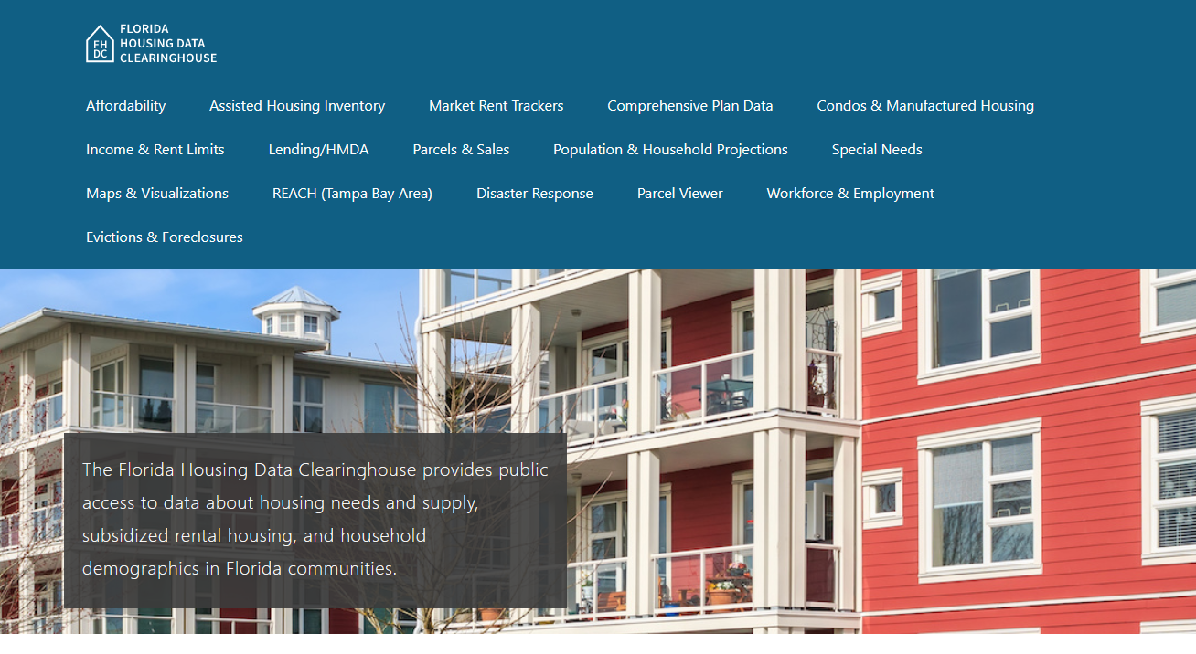
Contact
Shimberg Center for Housing Studies
352-273-1192
Main site: http://www.shimberg.ufl.edu
Data clearinghouse: http://flhousing.data.shimberg.ufl.edu

