Slide 1
Florida Housing Data Clearinghouse
Anne Ray
November 1, 2018

Slide 2
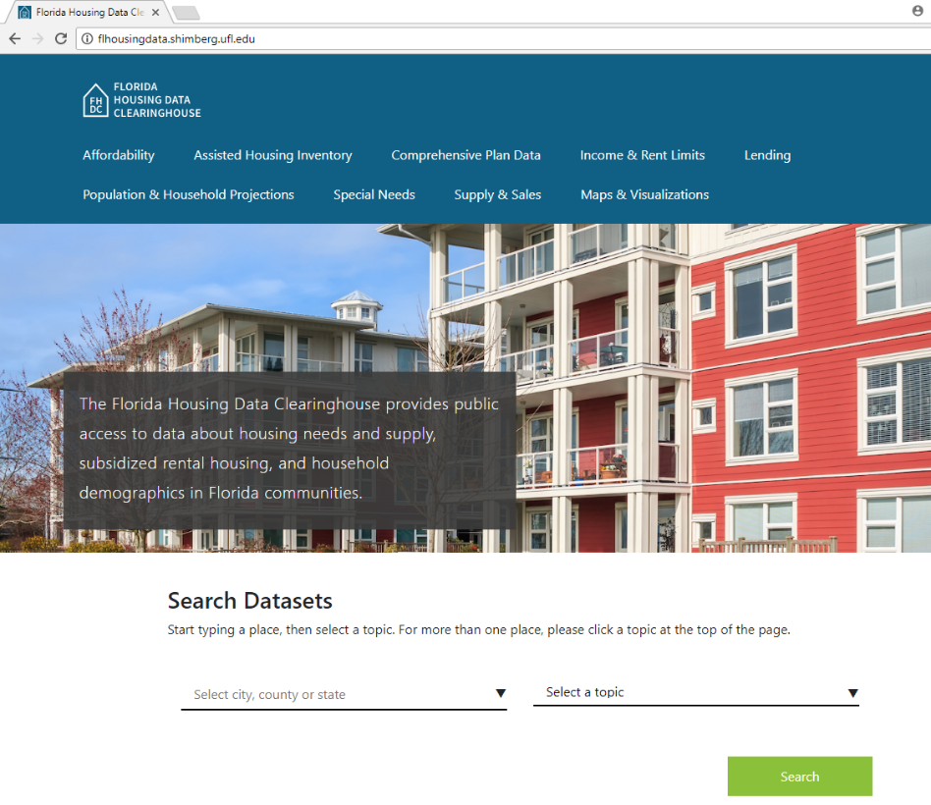
Florida Housing Data Clearinghouse site
What’s new
Streamlined data searches by topic or place
Maps & visualizations
Income & rent limits
Elder data site
What’s not
Nearly all previous datasets still on site
Excel download still available

Slide 3
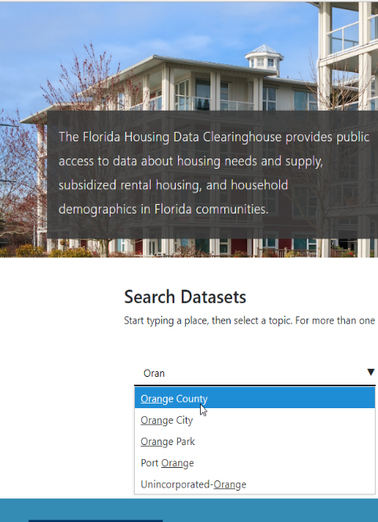
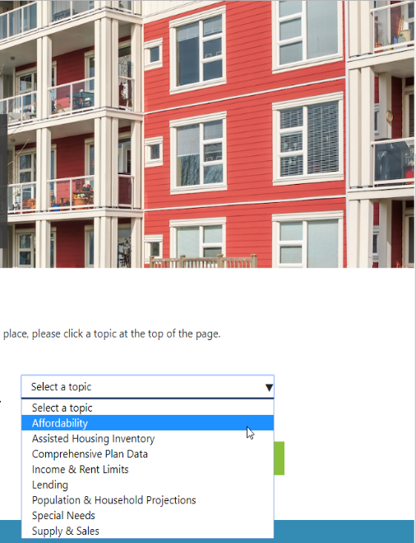
Search #1: Quick search for one place (city, county, state)
Start typing a place name, then pick from dropdown.
Pick topic from dropdown.
Click “Search.”

Slide 4
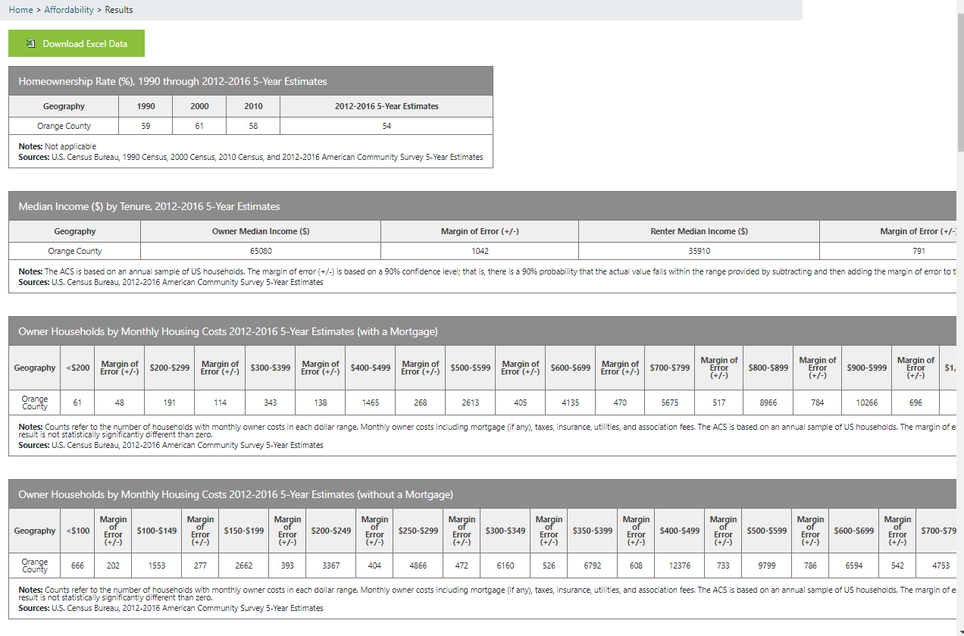
Search #1: Quick search for one place (city, county, state)
All tables for the topic load immediately
Excel download available

Slide 5
Search #2: Search by topic for one or more place
Click on a topic at the top of the page.

Slide 6
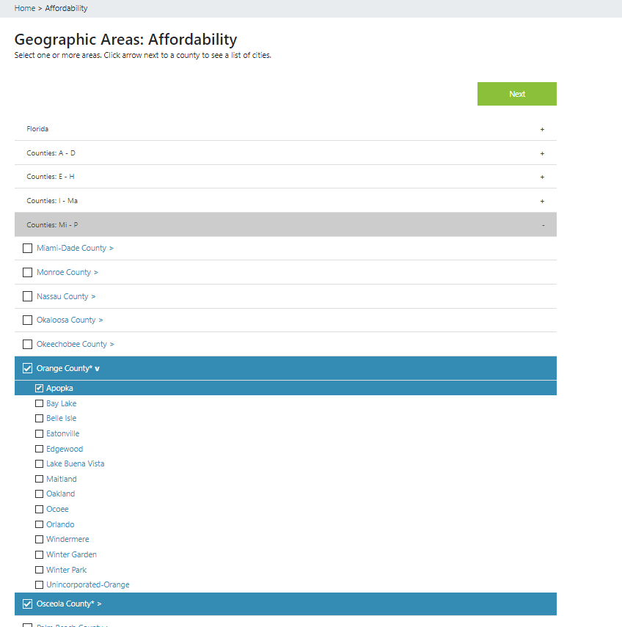
Search #2: Search by topic for one or more place
Select any combination of state, counties and cities. Use + to expand list of counties and _{ˇ} to show cities in a county.
Click “Next.”

Slide 7
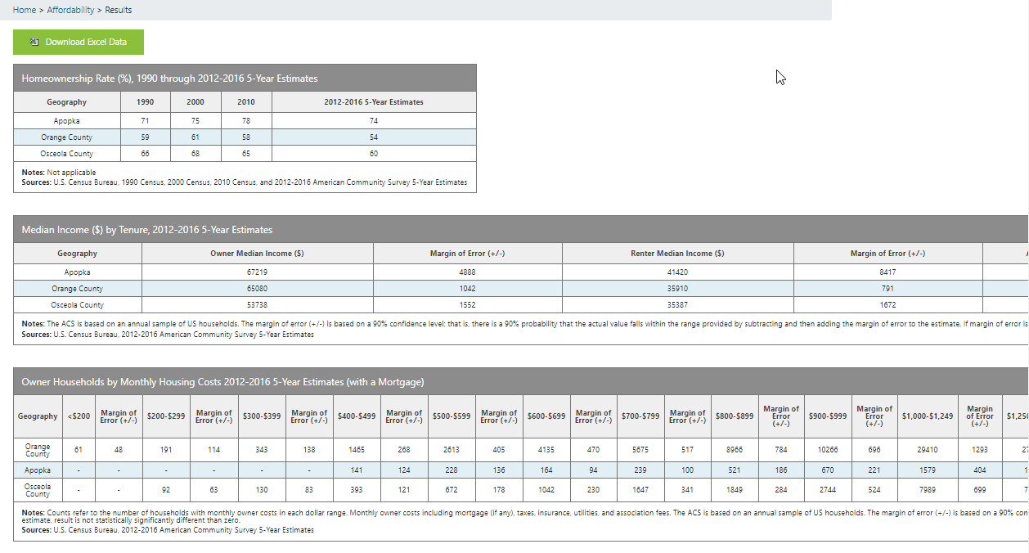
Search #2: Search by topic for one or more place
Results tables are the same, just for more than one place if chosen.

Slide 8
Search #2: Search by topic for one or more place, part 2

Slide 9
Beyond affordability: Datasets most relevant to fair housing
Assisted Housing Inventory
Subsidized rental developments (HUD, USDA, Florida Housing, local HFAs)
Tenant characteristics: income, race/ethnicity, elders, children

Slide 10
Beyond affordability: Datasets most relevant to fair housing
Lending
HMDA loan data
Application denial reasons
High interest loans
Approvals, high cost by race/ethnicity

Slide 11
Beyond affordability: Datasets most relevant to fair housing
Special Needs
Disability and housing cost burden
SSI benefits/rent comparison
Farmworker housing needs

Slide 12
Beyond affordability: Datasets most relevant to fair housing
Supply & Sales
Housing stock diversity (single family, multifamily)
Manufactured Housing Parks

Slide 13
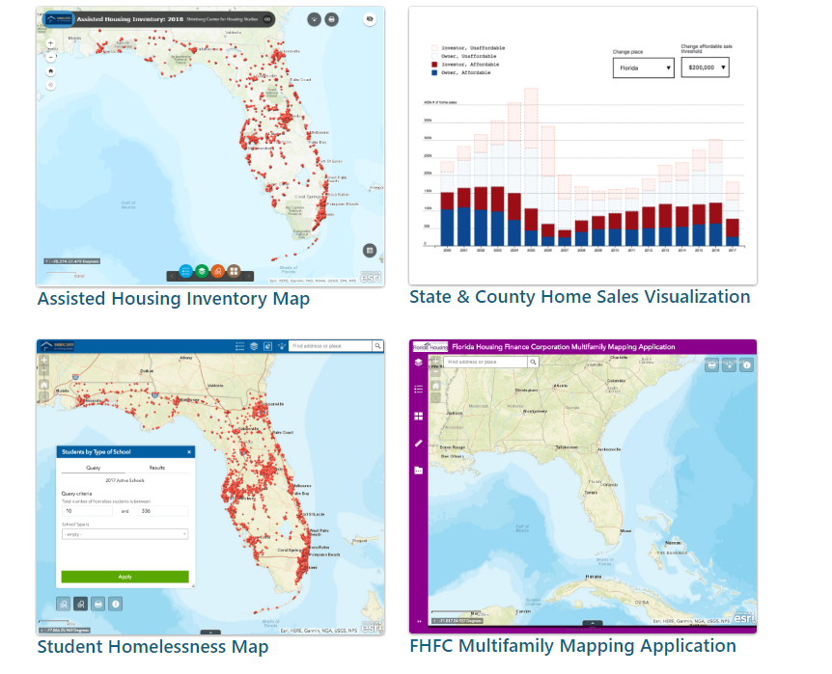
New feature: interactive maps and visualizations

Slide 14
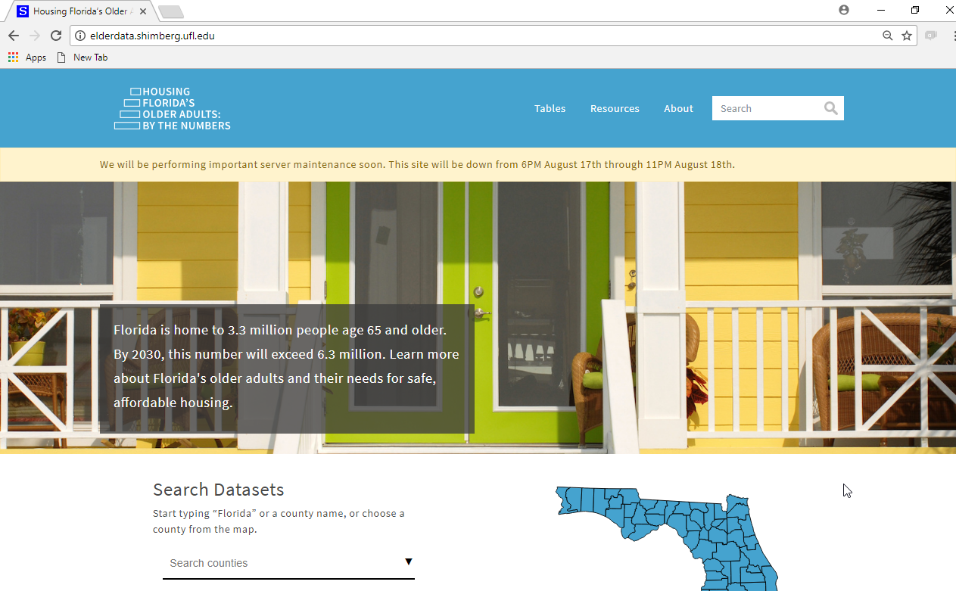
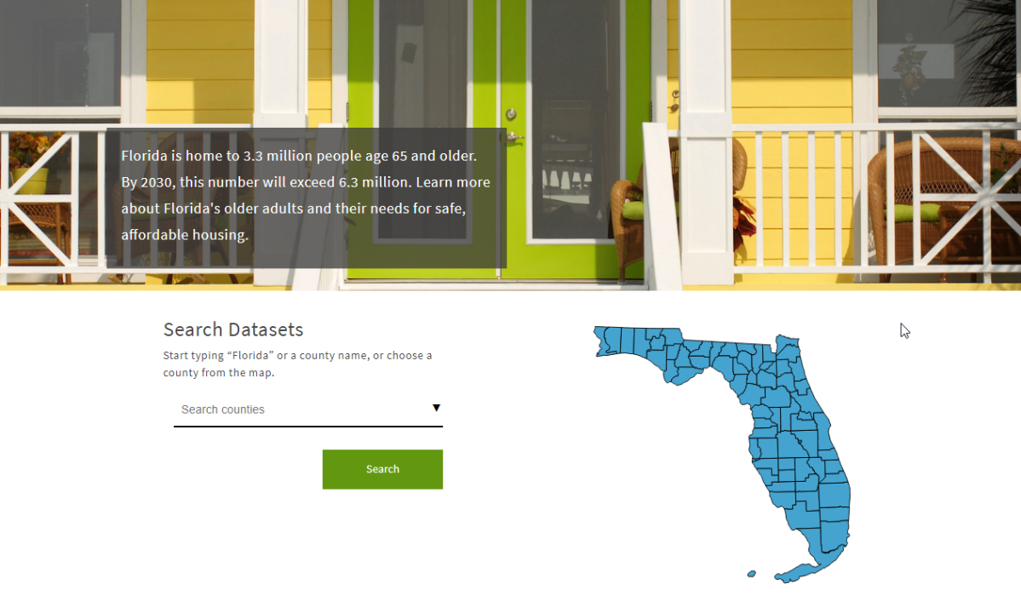
New feature: Housing Florida’s Older Adults data site

Slide 15
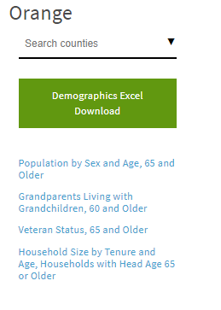
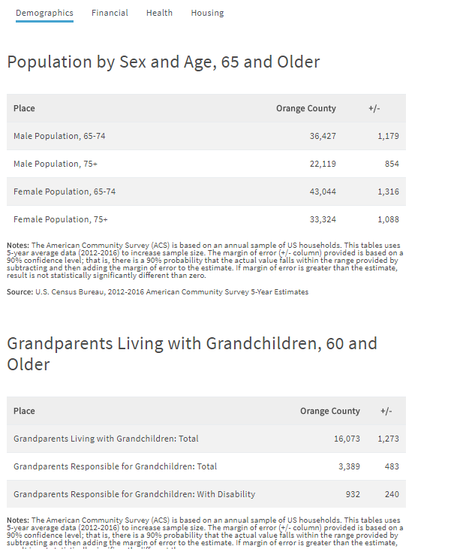
New feature: Housing Florida’s Older Adults data site

Slide 16
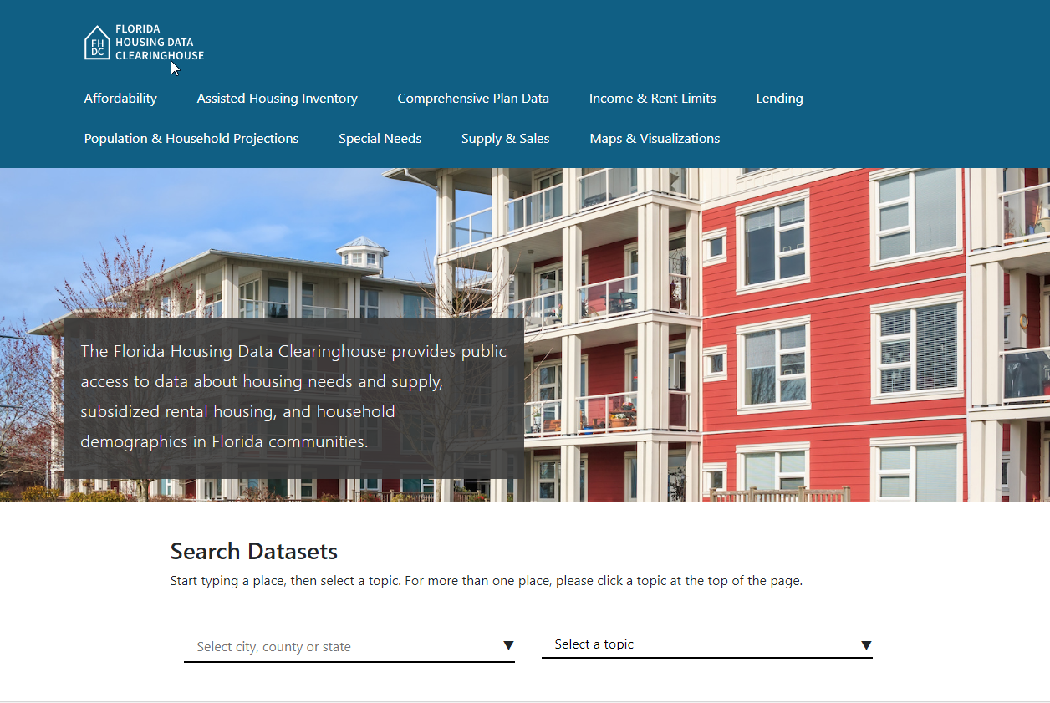
Contact: Anne Ray, Shimberg Center for Housing Studies
352-273-1195
aray@ufl.edu
Main site: www.shimberg.ufl.edu
Data site: data.shimberg.ufl.edu
Housing Florida’s Older Adults: elderdata.shimberg.ufl.edu

