Slide 1
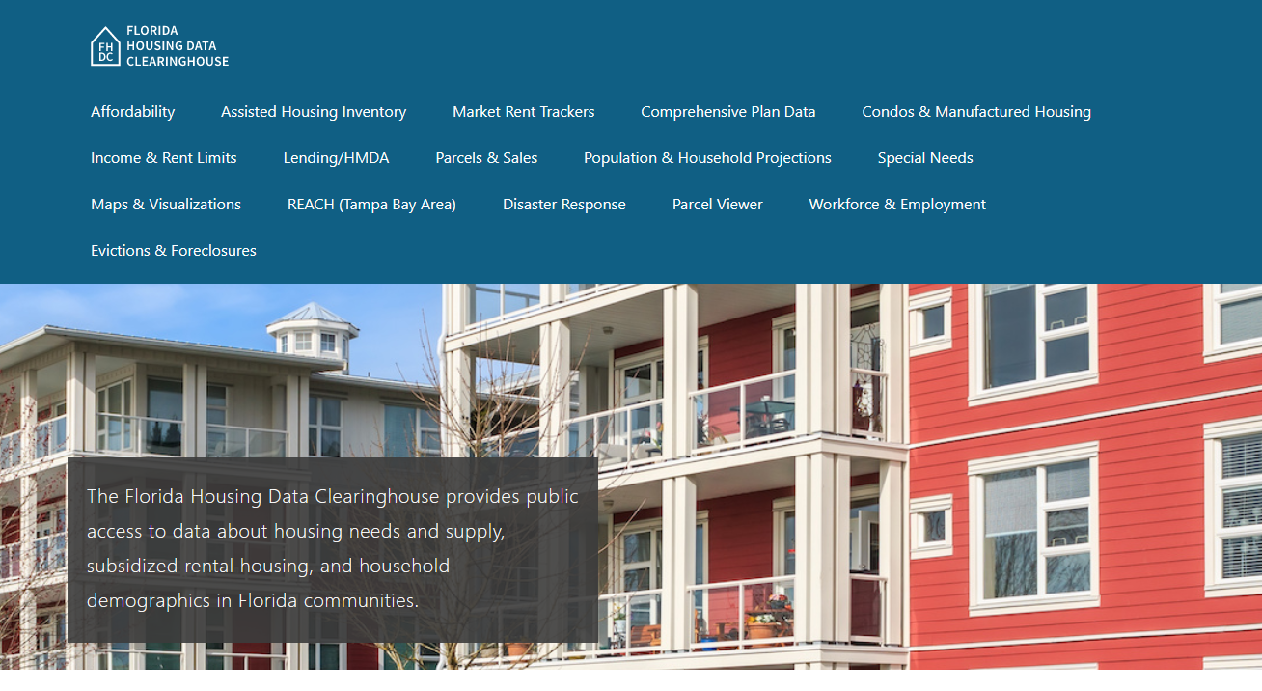
Collier County Housing Trends
June 2024

Slide 2
Collier County home prices consistently exceed statewide prices. Adjusted for inflation, prices in the county are well above mid-2000s boom era levels.
Collier County
Florida
Median Single Family Home Sale Price, Collier County & Florida, 2003-2023 (2023$)
Source: Shimberg Center analysis of Florida Department of Revenue, Sales Data Files. All values in 2023 dollars to correct for inflation.

Slide 3
Collier County added thousands of rental units between 2012 and 2022, but the increase was concentrated in units with rents above $1,200 (2022 dollars).
Net increase 2012-2022: 8,823 rental units
$1,200+ units grew by nearly 13,000
Units below $1,200 fell by nearly 3,900
Units by Gross Rent Above/Below $1,200 (2022 $), Collier County, 2012 & 2022
Source: Shimberg Center tabulation of U.S. Census Bureau, 2012 and 2021 American Community Survey. Year 2012 rents adjusted to 2022 dollars using Consumer Price Index.

Slide 4
Affordable Housing Terminology
Housing is usually considered to be affordable if it costs no more than 30% of household income.
Cost burdened: Paying more than 30% of income for owner or renter costs
Severely cost burdened: Paying more than 50% of income
Area median income (AMI): Used to create standard income measures across places and household sizes, expressed as % AMI

Slide 5
Example: 2024 Collier County Income (% AMI) and Housing Cost Limits
Income level | Annual income range (1-4 person household) | Hourly wage, 1 full-time job | Hourly wage, 2 full-time jobs | Max. affordable monthly housing cost (1-3 bedroom unit)
50% AMI | $36,550-52,150 | $18-$25 | $12-$13 | $978-$1,356
80% AMI | $58,480-83,440 | $28-$40 | $16-$20 | $1,566-$2,170
120% AMI | $87,720-125,160 | $42-$60 | $24-$30 | $2,349-$3,255
http://flhousingdata.shimberg.ufl.edu/income-and-rent-limits

Slide 6
Very low-income homeowners make up the largest group of cost-burdened households in Collier County.
Cost Burdened Households by Income as a Percentage of Area Median Income (AMI), Collier County, 2022
Source: Shimberg Center tabulation of U.S. Census Bureau, 2022 American Community Survey

Slide 7
Housing costs outpace wages for many occupations.
Collier County housing wage: $34.52/hour
A full-time worker would need to earn this amount to rent a typical 2BR apartment (HUD Fair Market Rent 2023: $1,795/mo).
Median wage for Collier County, 2023: $20.30/hour. A full-time, year-round worker with this wage can afford $1,056 in rent.
Sources: National Low Income Housing Coalition, Out of Reach; Shimberg Center tabulation of Florida Department of Economic Opportunity, Occupational Employment and Wage Statistics

Slide 8
How much can workers afford to pay for housing each month?
$600-799
$800-999
$1,000-1,200
Child, Family, and School Social Workers
Construction Laborers
Bartenders
Heavy and Tractor-Trailer Truck Drivers
Light Truck Drivers
Median, All Occupations
Medical Assistants
Office Clerks
Painters
Secretaries and Administrative Assistants
Veterinary Techs
Cashiers
Childcare Workers
Dishwashers
Farmworkers
Fast Food and Counter Workers
Home Health and Personal Care Aides
Hotel, Motel, and Resort Desk Clerks
Janitors and Cleaners
Laundry and Dry-Cleaning Workers
Maids and Housekeeping Cleaners
Retail Salespersons
Substitute Teachers
Waitstaff
Restaurant Cooks
Customer Service Reps
Food Preparation Workers
Hairdressers
Landscaping and Groundskeeping Workers
Nursing Assistants
Pharmacy Techs
Preschool Teachers
Receptionists
Security Guards
Tellers
Source: Shimberg Center tabulation of Florida Department of Economic Security, Occupational Employment Statistics and Wages. Based on median wage for occupations in Collier County. Assumes full-time worker, 30% of income spent on housing costs.

Slide 9
Eviction & foreclosure filings fell sharply in Q2 2020 during the state moratorium, then increased when filings were permitted again. Filings remain volatile.
Eviction & Foreclosure Filings, Collier County
Source: Shimberg Center tabulation of filing data from Florida Clerks & Comptrollers and Office of the State Courts Administrator.

Slide 10
Building a Local Housing System: The Affordable Housing Continuum
Supportive Housing (affordable units + services)
Homeless
Affordable rental housing
Public housing
Subsidized (Florida Housing, HUD, USDA)
Affordable home ownership
Shared equity (e.g. community land trust)
Down payment assistance
Older adults
People with disabilities
Other special needs
NOAH (Naturally Occurring Affordable Housing)
Low-interest loans
Affordable construction
Home rehab and weatherization
Vouchers

Slide 11
Contact
Shimberg Center for Housing Studies
352-273-1192
Main site: http://www.shimberg.ufl.edu
Data clearinghouse: http://flhousing.data.shimberg.ufl.edu

