Slide 1
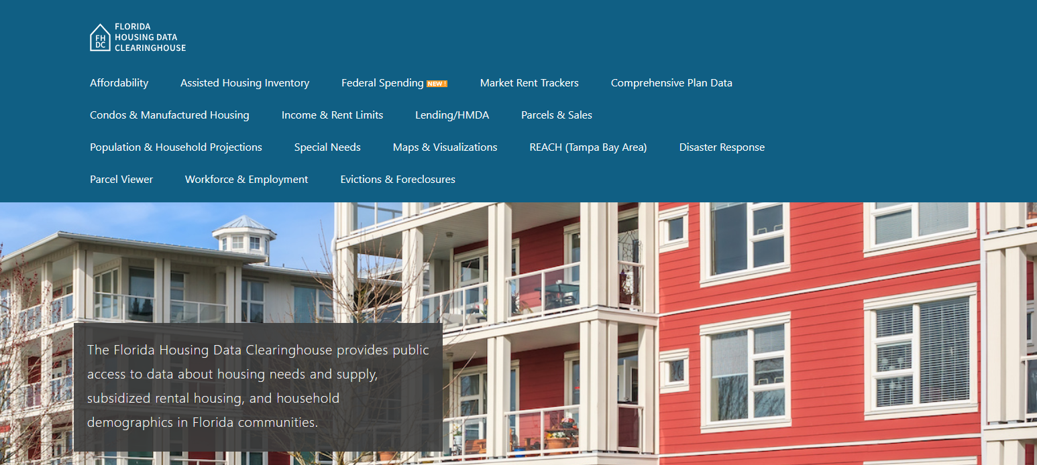

Clay County Housing Trends
Shimberg Center for Housing Studies
October 2025

Slide 2
Changes in Clay County’s home prices closely mirror statewide trends.
Florida
Clay County
Median Single Family Home Sale Price, Clay County & Florida, 2004-2024 (2024 $)
Source: Shimberg Center analysis of Florida Department of Revenue, Sales Data Files. All values in 2024 dollars to correct for inflation.

Slide 3
Affordable Housing Terminology
  Housing is usually considered to be affordable if it costs no more than 30% of household income.
  Cost burdened: Paying more than 30% of income for owner or renter costs
  Severely cost burdened: Paying more than 50% of income
  Area median income (AMI): Used to create standard income measures across places and household sizes, expressed as % AMI

Slide 4
2025 Clay County Income (% AMI) and Housing Cost Limits
Income level | Annual income range (1-4 person household) | Hourly wage, 1 full-time job | Hourly wage, 2 full-time jobs | Max. affordable monthly housing cost (1-3 bedroom unit)
50% AMI | $35,900-$51,250 | $17-$25 | - | $961-$1,332
80% AMI | $57,440-$82,000 | $28-$39 | $16-$20 | $1,538-$2,132
120% AMI | $86,160-$123,000 | $41-$59 | $23-$30 | $2,307-$3,198
http://flhousingdata.shimberg.ufl.edu/income-and-rent-limits

Slide 5
Very low-income owners make up the largest group of cost-burdened households in Clay County.
Cost Burdened Households by Income as a Percentage of Area Median Income (AMI), Clay County, 2023
Source: Shimberg Center tabulation of U.S. Census Bureau, 2023 American Community Survey. Student-headed, non-family households excluded.

Slide 6
Housing costs outpace wages for many occupations.
Jacksonville area housing wage: $33.27/hour
A full-time worker would need to earn this amount to rent a typical 2BR apartment (HUD Fair Market Rent 2025: $1,730/mo).
Median wage for Jacksonville area: $23.23/hour. A full-time, year-round worker with this wage can afford $1,208 in rent.
Sources: National Low Income Housing Coalition, Out of Reach; Shimberg Center tabulation of Florida Department of Economic Opportunity, Occupational Employment and Wage Statistics

Slide 7
How much can workers afford to pay for housing each month?
$600-799
$800-999
$1,000-1,200
Customer Service Rep
Fast Food Worker
Retail Salesperson
Cashier
Waiter
Housekeeper
Fast Food Cook
Hand Packer
Dining Attendant
Restaurant Host
Vehicle Cleaner
Hairdresser
Stocker
Laborer
Cook
Janitor
Security Guard
Nursing Asst
Food Prep Supervisor
Landscaper
Personal Care Aide
Office Clerk
Maintenance Worker
Secretary
Medical Secretary
Construction Laborer
Light Truck Driver
Medical Asst
Inventory Clerk
Billing Clerk
Source: Shimberg Center tabulation of Florida Department of Economic Security, Occupational Employment Statistics and Wages. Based on median wage for occupations in Clay County. Assumes full-time worker, 30% of income spent on housing costs.

Slide 8
Evictions & foreclosures fell sharply in Q2 2020 during the state moratorium, then increased when filings were permitted again.
Evictions
Foreclosures
Eviction & Foreclosure Filings, Clay County
Source: Shimberg Center tabulation of filing data from Florida Clerks & Comptrollers and Office of the State Courts Administrator.
Notes:
Foreclosures
Evictions

Slide 9
Building a Local Housing System: The Affordable Housing Continuum
Supportive Housing (affordable units + services)
Homeless
Affordable rental housing
Public housing
Subsidized (Florida Housing, HUD, USDA)
Affordable home ownership
Shared equity (e.g. community land trust)
Down payment assistance
Older adults
People with disabilities
Other special needs
NOAH (Naturally Occurring Affordable Housing)
Low-interest loans
Affordable construction
Home rehab and weatherization
Vouchers

Slide 10
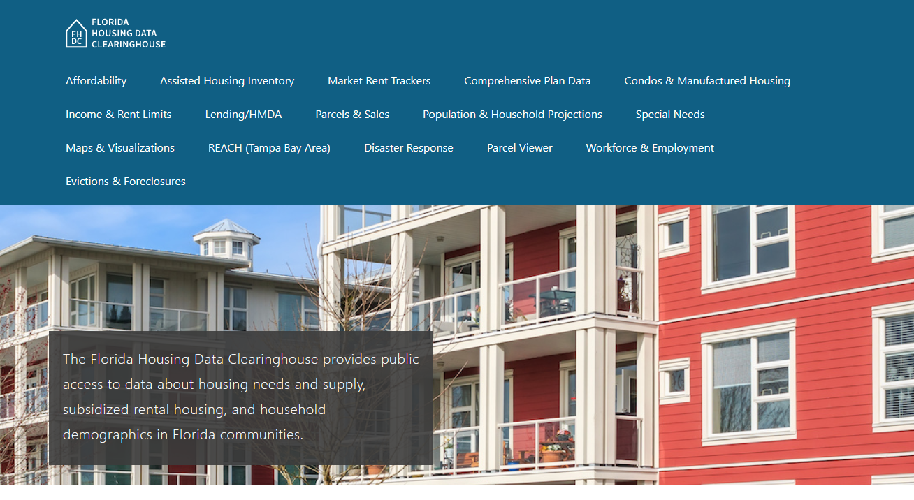
Contact
Shimberg Center for Housing Studies
352-273-1192
Main site: http://www.shimberg.ufl.edu
Data clearinghouse: http://flhousing.data.shimberg.ufl.edu

