Slide 1
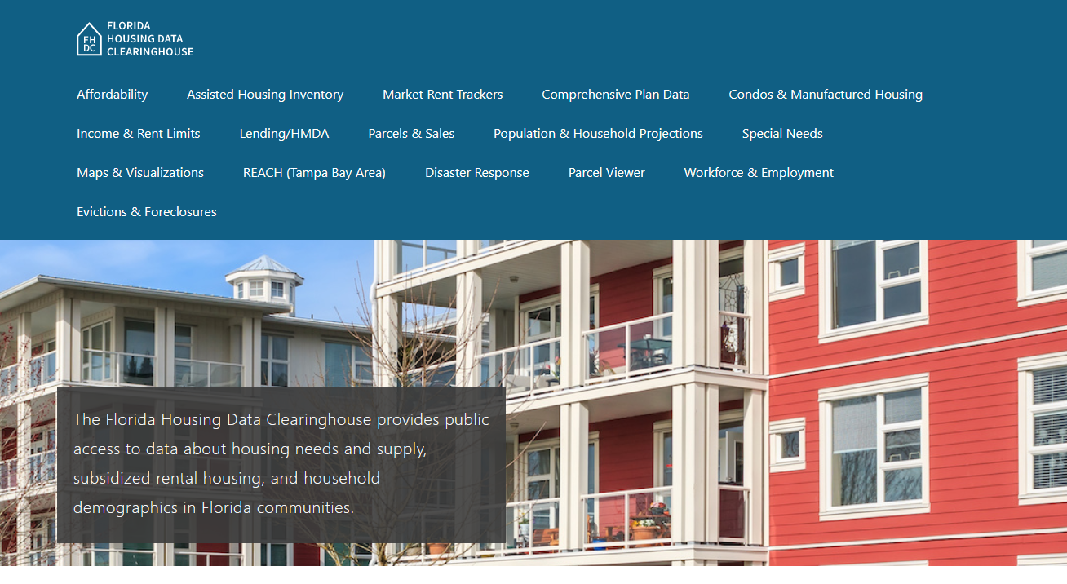
Citrus County Housing Trends
June 2024

Slide 2
Citrus County has consistently offered a more affordable single family market than the state as a whole. Both county and state median home prices now exceed mid-2000s boom-era levels.
Florida
Citrus
County
Median Single Family Home Sale Price, Citrus County & Florida, 2003-2023 (2023$)
Source: Shimberg Center analysis of Florida Department of Revenue, Sales Data Files. All values in 2023 dollars to correct for inflation.

Slide 3
Affordable Housing Terminology
Housing is usually considered to be affordable if it costs no more than 30% of household income.
Cost burdened: Paying more than 30% of income for owner or renter costs
Severely cost burdened: Paying more than 50% of income
Area median income (AMI): Used to create standard income measures across places and household sizes, expressed as % AMI

Slide 4
Example: 2024 Citrus County Income (% AMI) and Housing Cost Limits
Income level | Annual income range (1-4 person household) | Hourly wage, 1 full-time job | Hourly wage, 2 full-time jobs | Max. affordable monthly housing cost (1-3 bedroom unit)
50% AMI | $23,300-33,250 | $12-$16 | - | $623-$865
80% AMI | $37,280-53,200 | $18-$26 | $13-$13 | $998-$1,384
120% AMI | $55,920-79,800 | $27-$38 | $15-$19 | $1,497-$2,076
http://flhousingdata.shimberg.ufl.edu/income-and-rent-limits

Slide 5
Very low-income homeowners make up the largest group of cost-burdened households in Citrus County.
Cost Burdened Households by Income as a Percentage of Area Median Income (AMI), Citrus County, 2022
Source: Shimberg Center tabulation of U.S. Census Bureau, 2022 American Community Survey
Note: Red/Underlined numbers indicate values that are not statistically significant

Slide 6
Housing costs outpace wages for many occupations.
Citrus County housing wage: $18.60/hour
A full-time worker would need to earn this amount to rent a typical 2BR apartment (HUD Fair Market Rent 2023: $967/mo).
Median wage for Citrus County, 2023: $17.89/hour. A full-time, year-round worker with this wage can afford $930 in rent.
Sources: National Low Income Housing Coalition, Out of Reach; Shimberg Center tabulation of Florida Department of Economic Opportunity, Occupational Employment and Wage Statistics

Slide 7
How much can workers afford to pay for housing each month?
$600-799
$800-999
$1,000-1,200
Auto Techs and Mechanics
Bartenders
Carpenters
HVAC and Refrigeration Mechanics
Paralegals and Legal Assistants
Paramedics
Plumbers, Pipefitters, and Steamfitters
Police and Sheriff's Patrol Officers
Cashiers
Restaurant Cooks
Dishwashers
Food Preparation Workers
Hairdressers
Home Health and Personal Care Aides
Hotel, Motel, and Resort Desk Clerks
Janitors and Cleaners
Landscaping and Groundskeeping Workers
Laundry and Dry-Cleaning Workers
Maids and Housekeeping Cleaners
Nursing Assistants
Preschool Teachers
Receptionists
Retail Salespersons
Security Guards
Waitstaff
Child, Family, and School Social Workers
Construction Laborers
Customer Service Reps
Dental Assistants
Firefighters
Heavy and Tractor-Trailer Truck Drivers
Light Truck Drivers
Median, All Occupations
Medical Assistants
Office Clerks
Pharmacy Techs
Roofers
Secretaries and Administrative Assistants
Tellers
Veterinary Techs
Fast Food and Counter Workers (<$600)
Source: Shimberg Center tabulation of Florida Department of Economic Security, Occupational Employment Statistics and Wages. Based on median wage for occupations in Citrus County. Assumes full-time worker, 30% of income spent on housing costs.

Slide 8
Building a Local Housing System: The Affordable Housing Continuum
Supportive Housing (affordable units + services)
Homeless
Affordable rental housing
Public housing
Subsidized (Florida Housing, HUD, USDA)
Affordable home ownership
Shared equity (e.g. community land trust)
Down payment assistance
Older adults
People with disabilities
Other special needs
NOAH (Naturally Occurring Affordable Housing)
Low-interest loans
Affordable construction
Home rehab and weatherization
Vouchers

Slide 9
Eviction & foreclosure filings fell sharply in Q2 2020 during the state moratorium, then increased when filings were permitted again. Filings are closer to pre-pandemic levels but remain volatile.
Eviction & Foreclosure Filings, Citrus County
Source: Shimberg Center tabulation of filing data from Florida Clerks & Comptrollers and Office of the State Courts Administrator.

Slide 10
Contact
Shimberg Center for Housing Studies
352-273-1192
Main site: http://www.shimberg.ufl.edu
Data clearinghouse: http://flhousing.data.shimberg.ufl.edu

