Slide 1


Citrus County Housing Trends
Shimberg Center for Housing Studies
October 2025

Slide 2
Home prices in Citrus County have consistently been more affordable than statewide prices
Florida
Citrus County
Median Single Family Home Sale Price, Citrus County & Florida, 2004-2024 (2024 $)
Source: Shimberg Center analysis of Florida Department of Revenue, Sales Data Files. All values in 2024 dollars to correct for inflation.

Slide 3
Affordable Housing Terminology
  Housing is usually considered to be affordable if it costs no more than 30% of household income.
  Cost burdened: Paying more than 30% of income for owner or renter costs
  Severely cost burdened: Paying more than 50% of income
  Area median income (AMI): Used to create standard income measures across places and household sizes, expressed as % AMI

Slide 4
2025 Citrus County Income (% AMI) and Housing Cost Limits
Income level | Annual income range (1-4 person household) | Hourly wage, 1 full-time job | Hourly wage, 2 full-time jobs | Max. affordable monthly housing cost (1-3 bedroom unit)
50% AMI | $25,450-$36,300 | $14-$17 | - | $681-$944
80% AMI | $40,720-$58,080 | $20-$28 | $14 | $1,090-$1,511
120% AMI | $61,080-$87,120 | $29-$42 | $17-$21 | $1,635-$2,266
http://flhousingdata.shimberg.ufl.edu/income-and-rent-limits

Slide 5
Very low-income owners make up the largest group of cost-burdened households in Citrus County.
Cost Burdened Households by Income as a Percentage of Area Median Income (AMI), Citrus County, 2023
Source: Shimberg Center tabulation of U.S. Census Bureau, 2023 American Community Survey. Student-headed, non-family households excluded.

Slide 6
Housing costs outpace wages for many occupations.
Homosassa Springs MSA housing wage: $23.04/hour
A full-time worker would need to earn this amount to rent a typical 2BR apartment (HUD Fair Market Rent 2025: $1,198/mo).
Median wage for Homosassa Springs MSA: $19.05/hour. A full-time, year-round worker with this wage can afford $991 in rent.
Sources: National Low Income Housing Coalition, Out of Reach; Shimberg Center tabulation of Florida Department of Economic Opportunity, Occupational Employment and Wage Statistics

Slide 7
How much can workers afford to pay for housing each month?
$600-799
$800-999
$1,000-1,200
Bookkeeper
Retail Salesperson
Median, all occupations
Waiter
Fast Food Worker
Cashier
Janitor
Personal Care Aide
Housekeeper
Bartender
Dishwasher
Dining Attendant
Restaurant Host
Stocker
Office Clerk
Nursing Asst
Cook
Customer Service Rep
Landscaper
Food Prep Supervisor
Construction Laborer
Maintenance Worker
Retail Supervisor
Heavy Truck Driver
Equipment Operator
Carpenter
Plumber
Roofer
Postal Worker
School Bus Driver
Paramedic
Pest Control Worker
Source: Shimberg Center tabulation of Florida Department of Economic Security, Occupational Employment Statistics and Wages. Based on median wage for occupations in Citrus County. Assumes full-time worker, 30% of income spent on housing costs.

Slide 8
Building a Local Housing System: The Affordable Housing Continuum
Supportive Housing (affordable units + services)
Homeless
Affordable rental housing
Public housing
Subsidized (Florida Housing, HUD, USDA)
Affordable home ownership
Shared equity (e.g. community land trust)
Down payment assistance
Older adults
People with disabilities
Other special needs
NOAH (Naturally Occurring Affordable Housing)
Low-interest loans
Affordable construction
Home rehab and weatherization
Vouchers

Slide 9
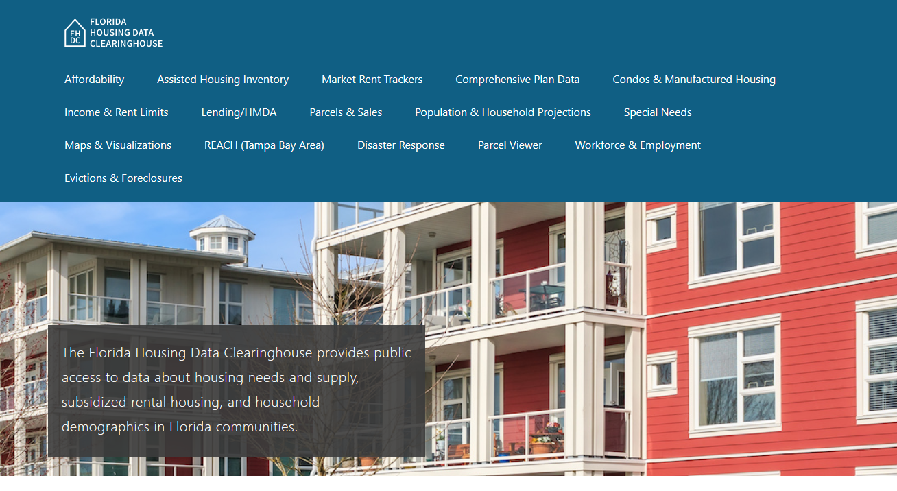
Contact
Shimberg Center for Housing Studies
352-273-1192
Main site: http://www.shimberg.ufl.edu
Data clearinghouse: http://flhousing.data.shimberg.ufl.edu

