Slide 1
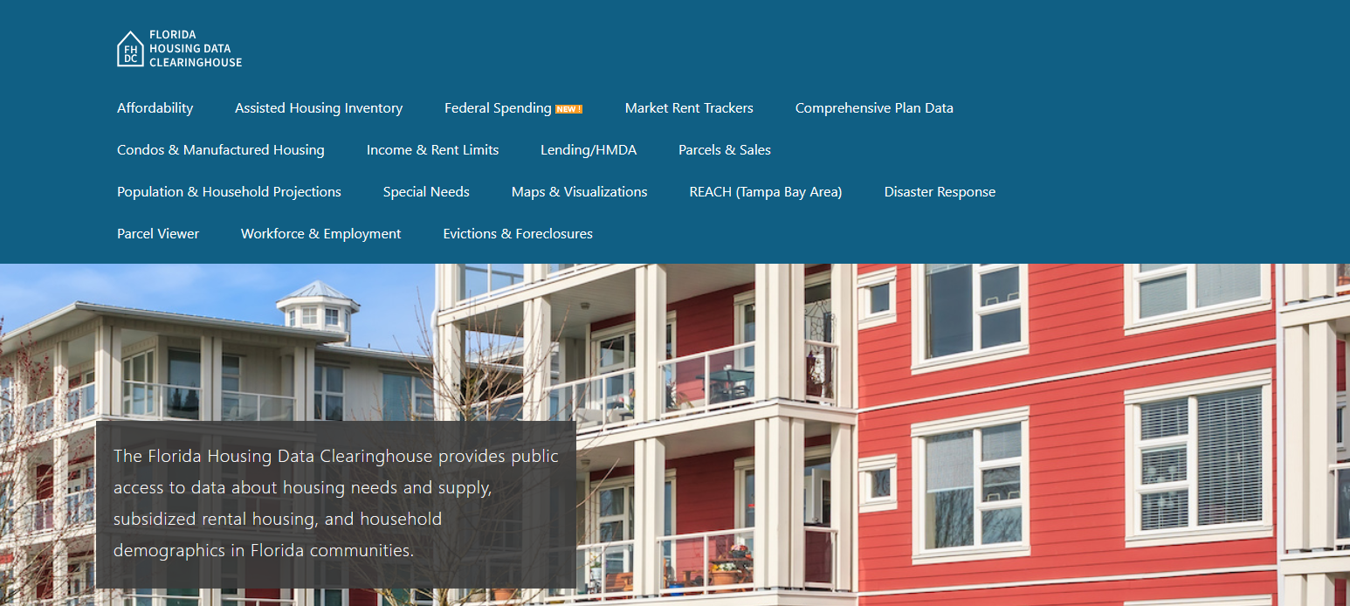

Brevard County Housing Trends
Shimberg Center for Housing Studies
October 2025

Slide 2
Brevard County home prices have been less volatile than statewide prices.
Florida
Brevard County
Median Single Family Home Sale Price, Brevard County & Florida, 2004-2024 (2024$)
Source: Shimberg Center analysis of Florida Department of Revenue, Sales Data Files. All values in 2024 dollars to correct for inflation.

Slide 3
Units renting for $1,200 or less (2023 $) dropped sharply between 2013 and 2023.
Net change 2013-2023: -2,503 rental units
$1,200+ units grew by nearly 18,000
Units at or below $1,200 fell by over 20,000
Units by Gross Rent Above/Below $1,000 (2023 $), Brevard County, 2013 & 2023
Source: Shimberg Center tabulation of U.S. Census Bureau, 2013 and 2023 American Community Survey. Year 2013 rents adjusted to 2023 dollars using Consumer Price Index. Student-headed, non-family occupied units excluded.

Slide 4
Affordable Housing Terminology
Housing is usually considered to be affordable if it costs no more than 30% of household income.
Cost burdened: Paying more than 30% of income for owner or renter costs
Severely cost burdened: Paying more than 50% of income
Area median income (AMI): Used to create standard income measures across places and household sizes, expressed as % AMI

Slide 5
2025 Brevard County Income (% AMI) and Housing Cost Limits
Income level | Annual income range (1-4 person household) | Hourly wage, 1 full-time job | Hourly wage, 2 full-time jobs | Max. affordable monthly housing cost (1-3 bedroom unit)
50% AMI | $35,000-$49,950 | $17-$24 | - | $937-$1,298
80% AMI | $56,000-$79,920 | $27-$38 | $15-$19 | $1,500-$2,078
120% AMI | $84,000-$119,880 | $40-$58 | $23-$29 | $2,250-$3,117
http://flhousingdata.shimberg.ufl.edu/income-and-rent-limits

Slide 6
Very low-income owners make up the largest group of cost-burdened households in Brevard County.
Cost Burdened Households by Income as a Percentage of Area Median Income (AMI), Brevard County, 2023
Source: Shimberg Center tabulation of U.S. Census Bureau, 2023 American Community Survey. Student-headed, non-family households excluded.

Slide 7
Housing costs outpace wages for many occupations.
Palm Bay-Melbourne-Titusville MSA housing wage: $31.44/hour
A full-time worker would need to earn this amount to rent a typical 2BR apartment (HUD Fair Market Rent 2025: $1,635/mo).
Median wage for Palm Bay-Melbourne-Titusville MSA: $23.51/hour. A full-time, year-round worker with this wage can afford $1,222 in rent.
Sources: National Low Income Housing Coalition, Out of Reach; Shimberg Center tabulation of Florida Department of Economic Opportunity, Occupational Employment and Wage Statistics

Slide 8
How much can workers afford to pay for housing each month?
$600-799
$800-999
$1,000-1,200
Office Clerk
Retail Salesperson
Customer Service Rep
Fast Food Worker
Waiter
Cashier
Bartender
Housekeeper
Dishwasher
Dining Attendant
Restaurant Host
Hand Packer
Stocker
Cook
Janitor
Laborer
Nursing Asst
Food Prep Supervisor
Personal Care Aide
Food Prep Worker
Landscaper
Maintenance Worker
Secretary
Bookkeeper
Medical Secretary
Retail Supervisor
Construction Laborer
Medical Asst
Light Truck Driver
Electronics Assembler
Source: Shimberg Center tabulation of Florida Department of Economic Security, Occupational Employment Statistics and Wages. Based on median wage for occupations in Brevard County. Assumes full-time worker, 30% of income spent on housing costs.

Slide 9
Evictions & foreclosures fell sharply in Q2 2020 during the state moratorium, then increased when filings were permitted again.
Evictions
Foreclosures
Eviction & Foreclosure Filings, Brevard County
Source: Shimberg Center tabulation of filing data from Florida Clerks & Comptrollers and Office of the State Courts Administrator.
Notes:
Foreclosures
Evictions

Slide 10
Building a Local Housing System: The Affordable Housing Continuum
Supportive Housing (affordable units + services)
Homeless
Affordable rental housing
Public housing
Subsidized (Florida Housing, HUD, USDA)
Affordable home ownership
Shared equity (e.g. community land trust)
Down payment assistance
Older adults
People with disabilities
Other special needs
NOAH (Naturally Occurring Affordable Housing)
Low-interest loans
Affordable construction
Home rehab and weatherization
Vouchers

Slide 11
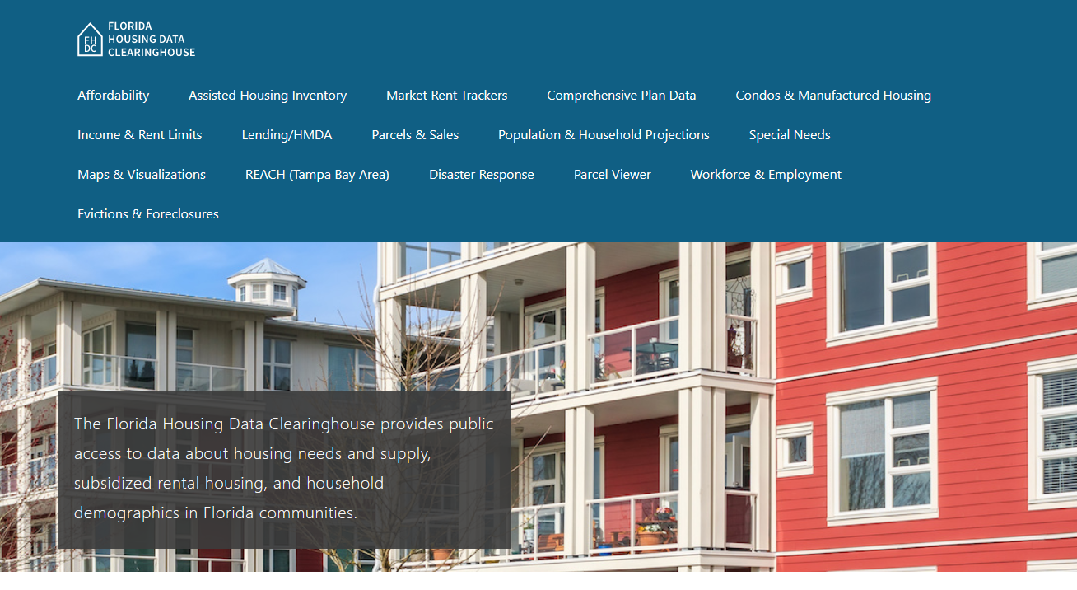
Contact
Shimberg Center for Housing Studies
352-273-1192
Main site: http://www.shimberg.ufl.edu
Data clearinghouse: http://flhousing.data.shimberg.ufl.edu

