Slide 1
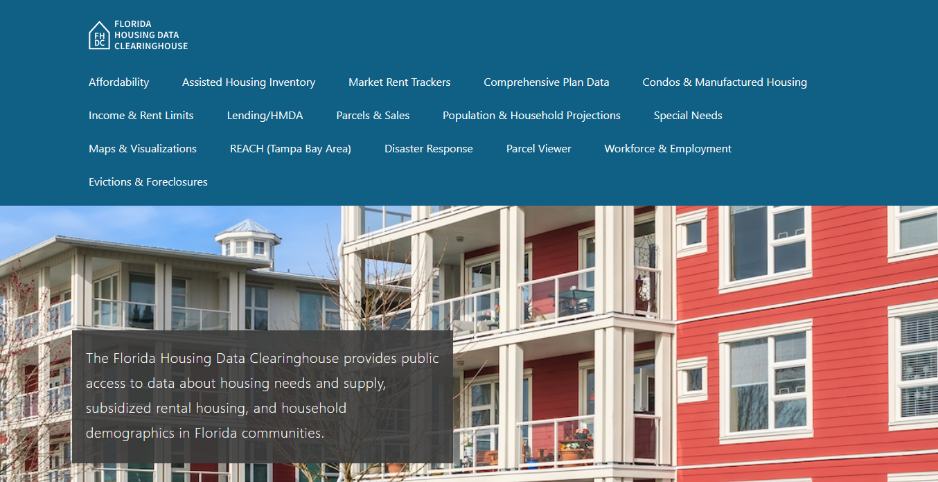

Contact
2025 Rental Market Study
Anne Ray
Shimberg Center for Housing Studies
June 13, 2025

Slide 2
Rental Market Study Organization
Statewide Trends
Core Needs Assessment
Counties & County Size
Household Size
Elders
Affordable/Available Units
Demographic Reports
Homeless
Special Needs
Farmworkers/Fishers
Assisted Housing Supply

Slide 3
Florida added over a million households 2019-2023, including 195,000 renters.
Statewide Trends
Households by Tenure, Florida, 2019 & 2023
Source: Shimberg Center tabulation of U.S. Census Bureau, 2019 and 2023 American Community Survey

Slide 4
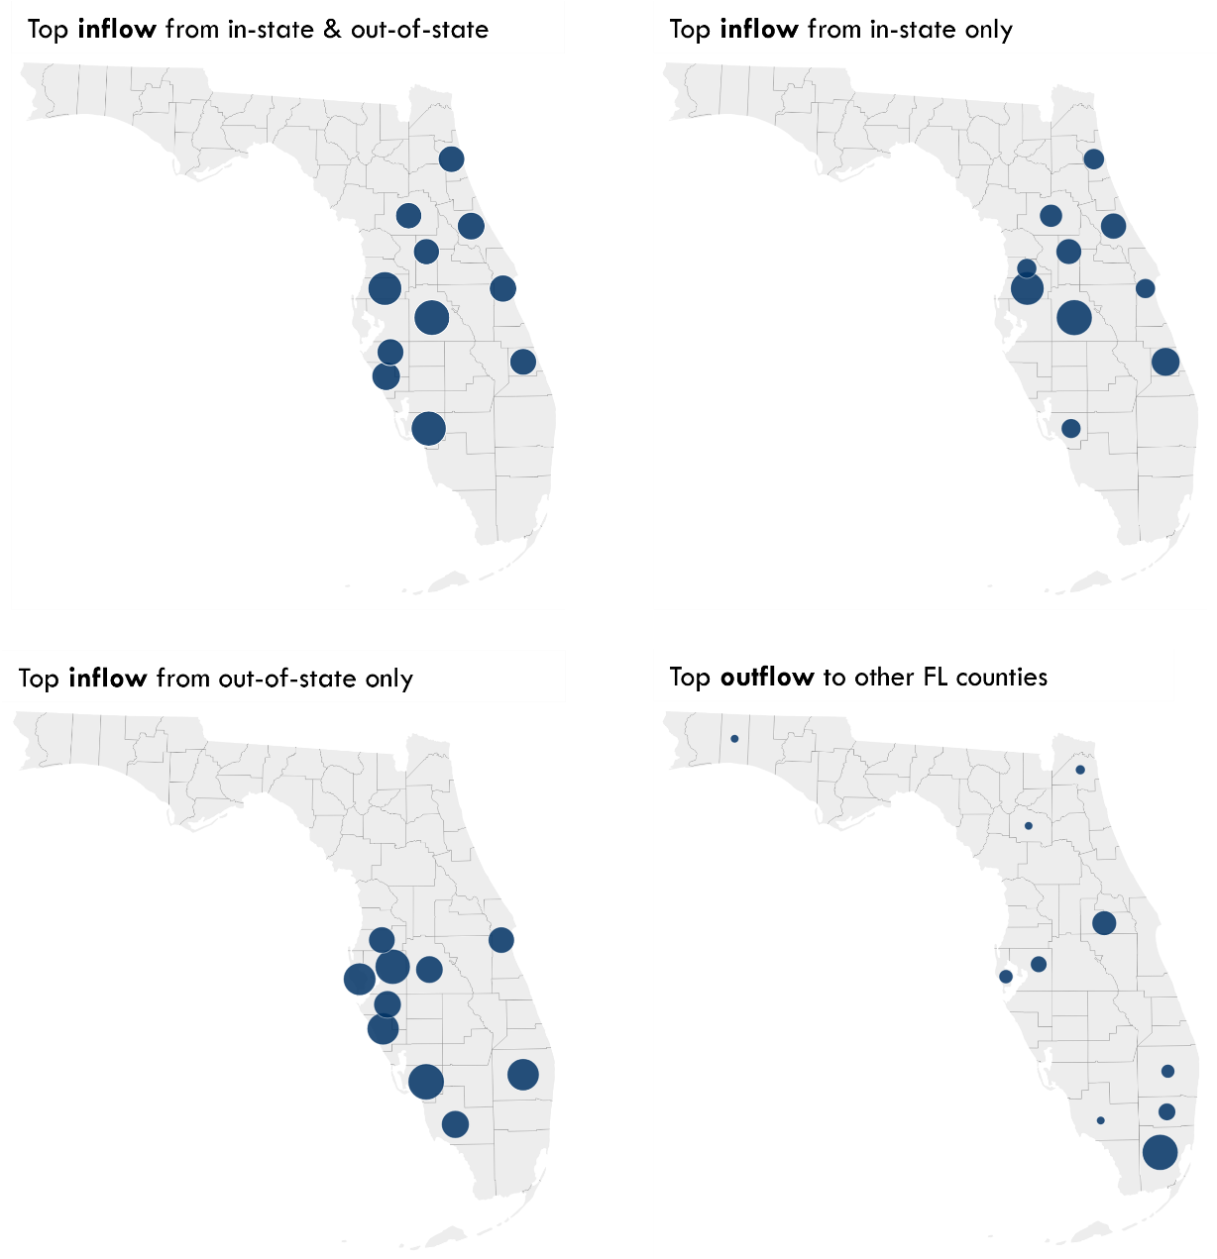
Household growth was driven by strong in-migration, particularly across the center of the state.
Statewide Trends
Top Counties for Net Inflow, 2018-2022
Polk, 37,949 households
Lee, 36,553
Pasco, 34,054
Sarasota, 23,764
Volusia, 22,030
Brevard, 21,433
Manatee, 20,752
St. Lucie, 20,712
St. Johns, 20,337
Marion, 19,744
Lake, 19,523
Includes in-state and out-of-state movers
Top Counties for Net Inflow/Outflow, 2018-2022
Source: Shimberg Center tabulation of U.S. Department of the Treasury, Statistics of Income, Individuals, State and County Migration Data

Slide 5
Florida’s growth in renter households was absorbed by an increase in multifamily supply, especially in larger buildings.
Statewide Trends
Renter-Occupied Units by Units in Structure, Florida, 2019 & 2023
Source: Shimberg Center tabulation of U.S. Census Bureau, 2019 and 2023 American Community Survey

Slide 6
Despite the increase in supply, median rent rose by 39% 2019-2023.
Statewide Trends
Median Gross Rent, Florida, 2019-2023
Source: Shimberg Center tabulation of U.S. Census Bureau, 2019/2021/2022/2023 American Community Survey. Gross rent includes rent paid to landlord and tenant-paid utilities. 2020 value not included due to limitations in data collection for the 2020 American Community Survey.

Slide 7
In the early years of Florida Housing’s programs, LIHTC rent limits were close to middle-market rents. Now, 60% AMI rents are well below market rents, and 30-50% AMI rents provide even deeper affordability. (Orlando area example)
Statewide Trends
Median Gross Rent vs. 2 Bedroom 30/50/60% AMI Rents, Orlando-Kissimmee-Sanford Metropolitan Statistical Area, 1990-2023
Source: Shimberg Center tabulation of U.S. Census Bureau, 1990 and 2000 Census and 2010/2015/2019/2023 American Community Survey; Florida Housing Finance Corporation Rent Limits

Slide 8
Renters at all income levels participate in the workforce. Most non-working renter households are made up of older adults or persons with disabilities.
Statewide Trends
Renter Households by Age/Disability, Work Status and Income (% AMI), Florida, 2023
Source: Shimberg Center tabulation of U.S. Census Bureau, 2023 American Community Survey. Student-headed, nonfamily households are excluded.

Slide 9
Service jobs are the most common occupations for Florida’s renters, including some of the fastest growing occupations in the state (starred).
Statewide Trends
 | Median hourly wage | Top Ten Occupations
 |  | 0-60% AMI Renters | All Renters
Customer Service Representatives* | $18.70 | X | X
Janitors and Building Cleaners* | $15.16 | X | X
Cooks | $13.91-28.64 | X | X
Retail Salespersons* | $15.36 | X | X
Cashiers | $14.10 | X | X
Waiters and Waitresses* | $14.22 | X | X
Driver/Sales Workers and Truck Drivers | $19.31-24.04 | X | X
Landscaping And Groundskeeping Workers | $17.32 | X
Nursing Assistants | $17.72 | X
Construction Laborers | $19.63 | X
Managers* | $25.13-80.61 |  | X
Registered Nurses | $39.83 |  | X
First-Line Supervisors of Retail Sales Workers | $22.65 |  | X
Top Ten Occupations for 0-60 Percent of AMI Renters and All Renters, Florida
Sources: Shimberg Center tabulation of U.S. Census Bureau, 2023 American Community Survey and Florida Department of Commerce, 2024 Occupational Employment Statistics and Wages. * entries are in Florida Commerce’s list of 10 occupations projected to add the most jobs by 2032.

Slide 10
Florida has an estimated 904,635 low-income, cost burdened renters.
Core Needs Assessment
Low-income: below 60% area median income (AMI)
Cost burdened: paying more than 40% of income for rent
Excludes student-headed, non-family households

Slide 11
Florida has an estimated 904,635 low-income, cost burdened renters.
Core Needs Assessment
73% of 0-60% AMI renter households are cost burdened, compared to:
45% of 60-80% AMI renters
21% of 80-100% AMI renters
11% of 100-120% AMI renters
6% of 120-140% AMI renters

Slide 12
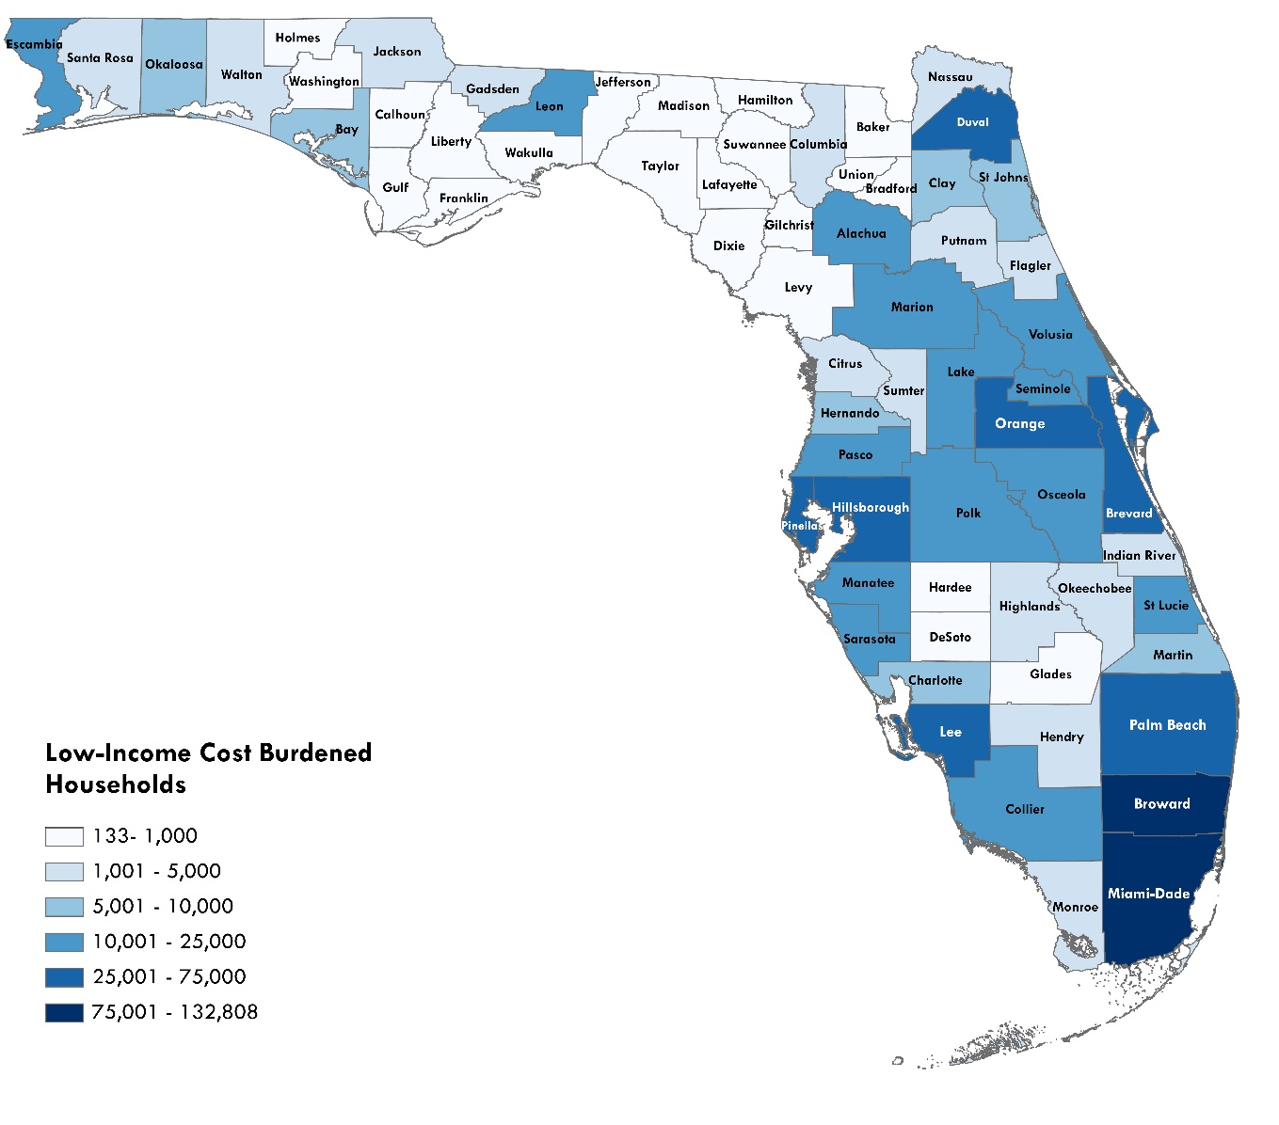
Cost Burdened Households by County
Core Needs Assessment
64.5% of cost burdened households are in large counties
32.9% in medium counties
2.6% in small counties
Low-Income (≤60% AMI), Cost Burdened (>40%) Renter Households by County, 2025
Sources: Shimberg Center tabulation of U.S. Census Bureau, 2023 American Community Survey; University of Florida Bureau of Economic and Business Research, 2025 Population Projections

Slide 13
Household Demographics: Size
Core Needs Assessment
68% of cost burdened households are 1-2 person
24% are 3-4 person
8% are 5+ person

Slide 14
Household Demographics: Elderly
Core Needs Assessment
352,861 cost burdened households (39%) headed by householder age 55+, including 70,787 (8%) age 75-84 and 35,281 (4%) age 85+
Highest shares (44-50%) in Southwest, Pasco/Pinellas, and Palm Beach/Treasure Coast
Additionally, 2024 Point in Time Count found 8,369 homeless persons age 55+

Slide 15
Household Demographics: Elderly
Core Needs Assessment
43% of age 55+ low-income, cost burdened renter households are headed by someone with a disability
28% include at least one employed household member
Age 55+ households are a core constituency in Florida’s affordable housing developments—not just in elder set-asides, but in units for families, homeless, and persons with disabilities

Slide 16
Affordable/Available Units
Affordable/Available
Compares number of renter households in an income group (0-30% AMI, 0-60% AMI, etc.) with supply of rental units
Affordable: with rent at or below AMI rent limit (30% monthly income)
Available: vacant or occupied by income-qualified household (at or below AMI income limit)

Slide 17
Statewide Affordable/Available Units
Affordable/Available
Number of Affordable Units, Affordable/Available Units, and Renter Households by Income, Florida, 2023
Source: Shimberg Center tabulation of U.S. Census Bureau, 2023 American Community Survey

Slide 18
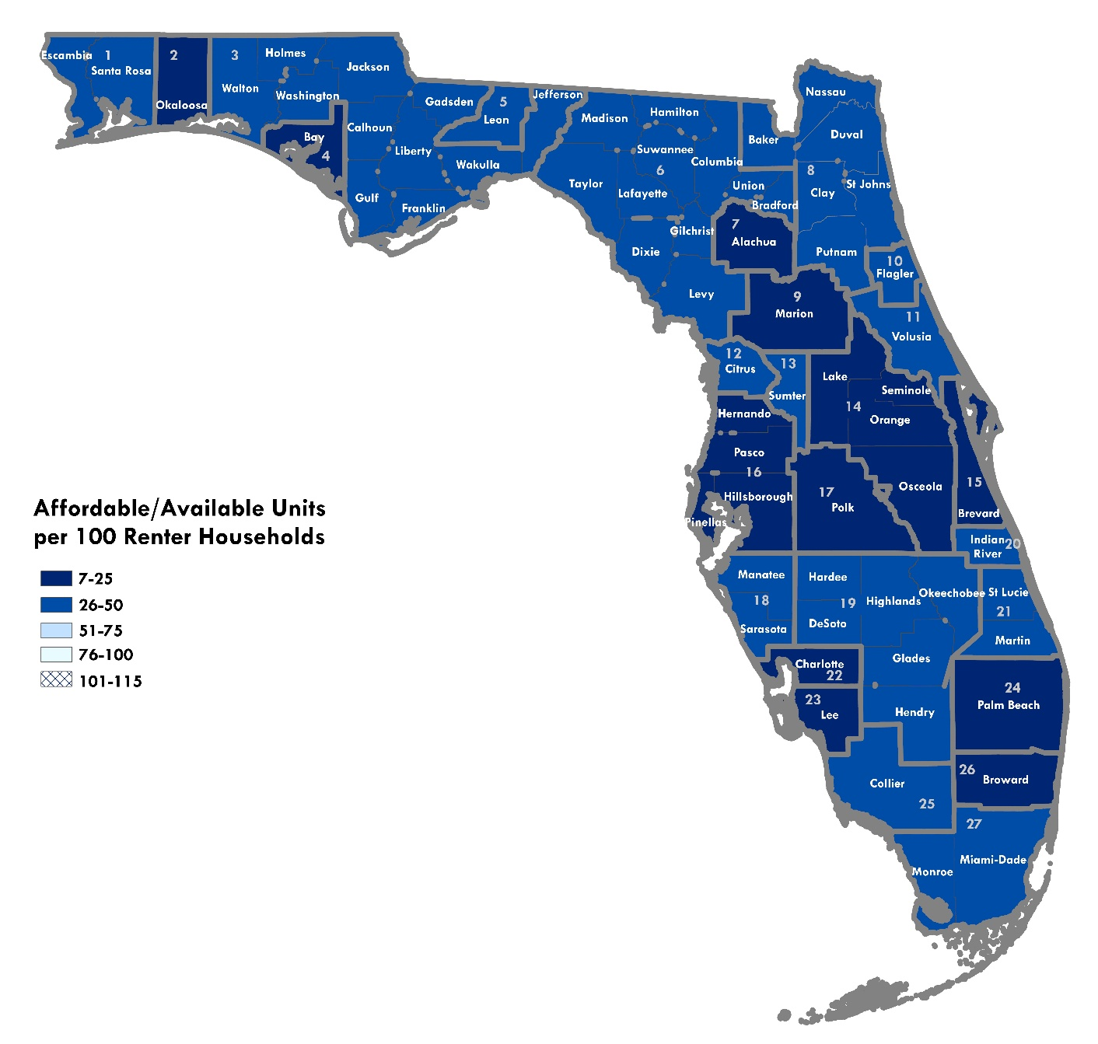
Regional Affordable/Available Units per 100 Renters: 0-30% AMI
Affordable/Available
Source: Shimberg Center analysis of U.S. Census Bureau, 2023 American Community Survey.

Slide 19
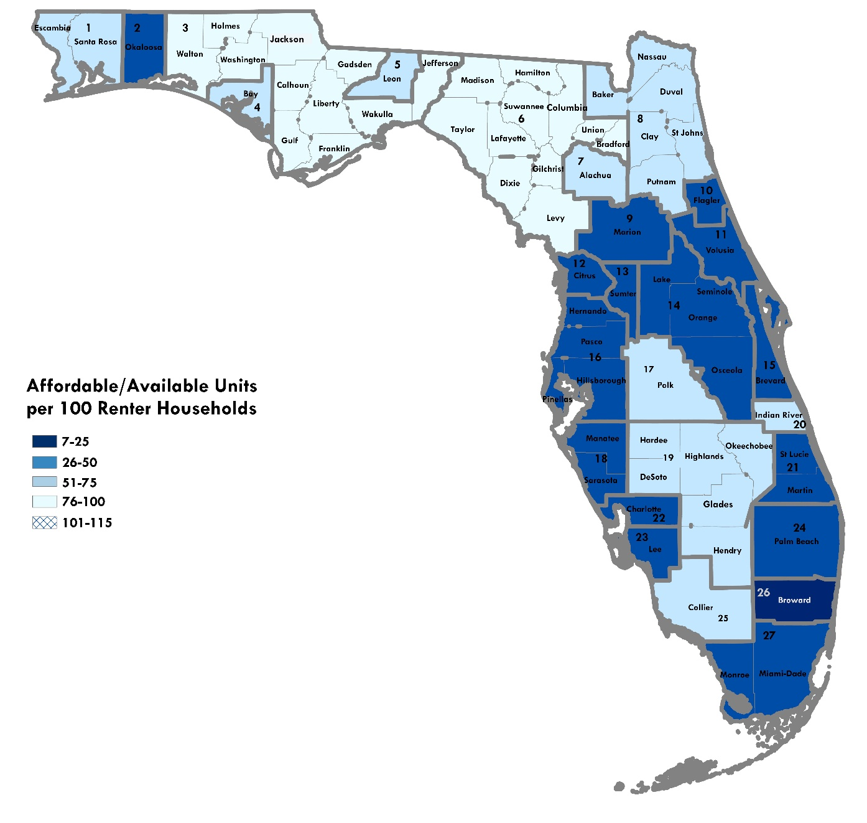
Regional Affordable/Available Units per 100 Renters: 0-60% AMI
Affordable/Available
Source: Shimberg Center analysis of U.S. Census Bureau, 2023 American Community Survey.

Slide 20
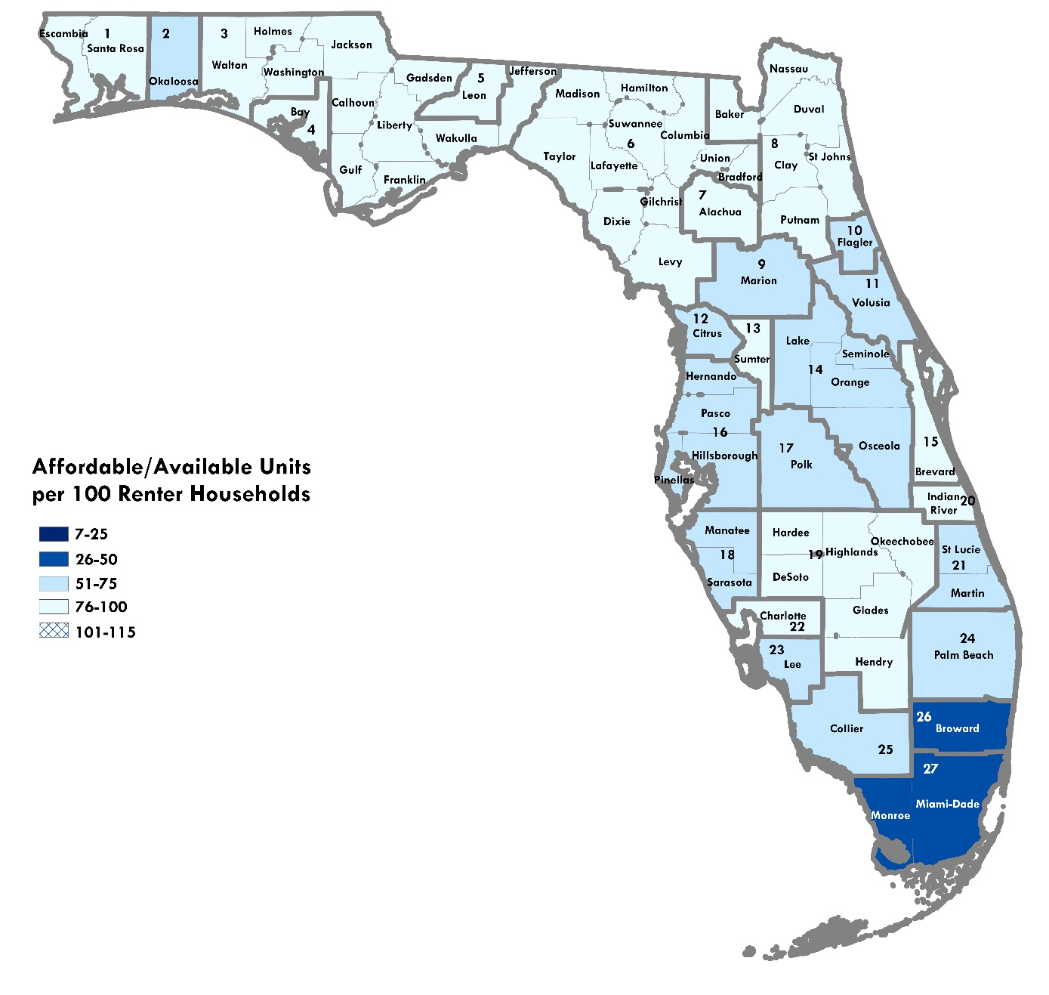
Regional Affordable/Available Units per 100 Renters: 0-80% AMI
Affordable/Available
Source: Shimberg Center analysis of U.S. Census Bureau, 2023 American Community Survey.

Slide 21
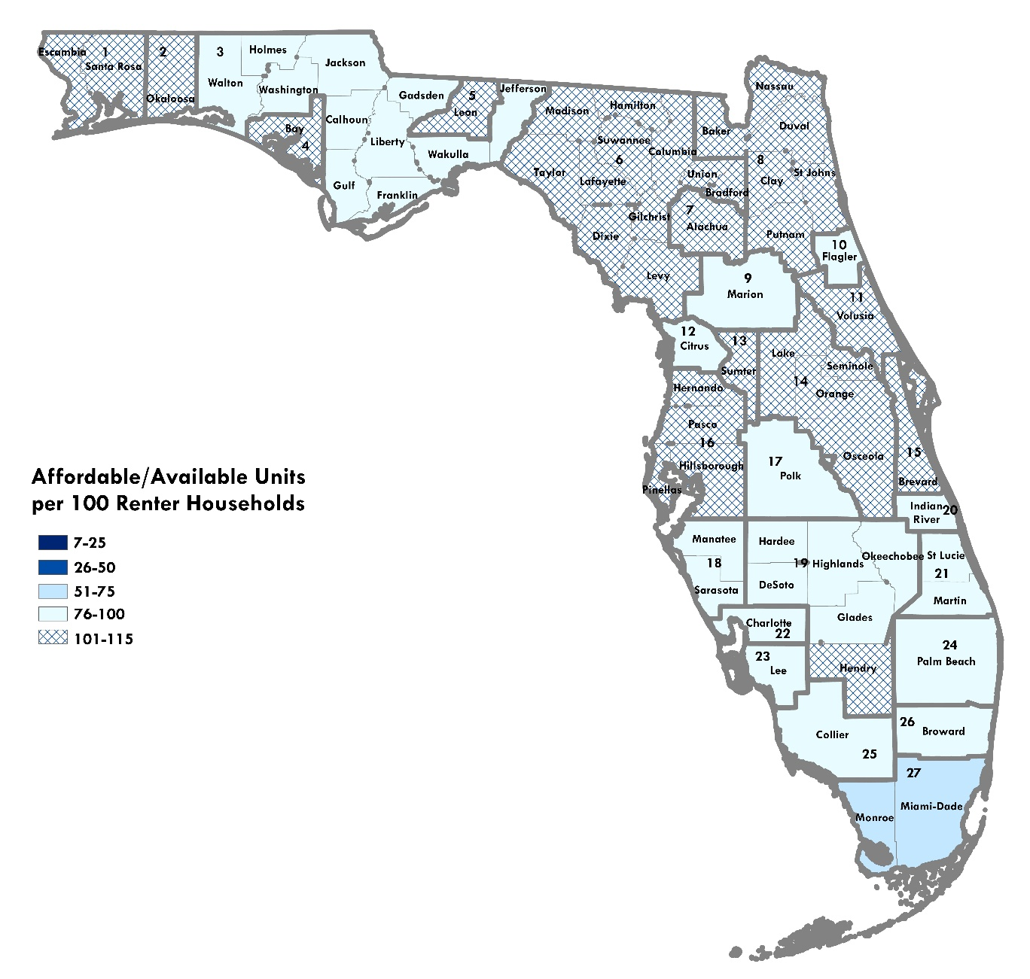
Regional Affordable/Available Units per 100 Renters: 0-120% AMI
Affordable/Available
Source: Shimberg Center analysis of U.S. Census Bureau, 2023 American Community Survey.

Slide 22
Homeless Individuals and Families: Counts
Demographic Reports
Individuals
29,848 homeless individuals (+14% from 2022 RMS)
16,221 transitional/permanent supportive housing beds
Families with children
44,234 homeless families with children (+28% from 2022 RMS)
8,953 transitional/permanent supportive housing units
Reasons for increases:
Increase in individuals in Point in Time count
Student data frequently affected by spikes in displacement due to hurricanes (Hurricane Ian in 2022-2023 school year)

Slide 23
Special Needs Definition
Demographic Reports
An adult person requiring independent living services in order to maintain housing or develop independent living skills and who has a disabling condition;
A young adult formerly in foster care who is eligible for services under s. 409.1451(5);
A survivor of domestic violence as defined in s. 741.28;
Or a person receiving benefits under the Social Security Disability Insurance (SSDI) program or the Supplemental Security Income (SSI) program or from veterans’ disability benefits.
Section 420.0004 (13), Florida Statutes

Slide 24
Special Needs Household Estimates
Demographic Reports
Adults with disabilities, receiving SSDI/SSI/VA benefits
92,545 low-income renter households
Survivors of domestic violence
7,147 households using emergency shelter (DCF)
Youth aging out of foster care
2,066 units for youth using post-foster care services (FL Assessment of Housing for Special Needs & Homeless Populations)
Total estimate: 101,758 households
11% of statewide total of 904,635 low-income, cost burdened renter households

Slide 25
Farmworkers
Demographic Reports
68,577 unaccompanied workers; 51,433 migrant camp beds
32,978 accompanied worker households; 3,730 farmworker set-aside units
Highest need counties:
Unaccompanied workers: Miami-Dade, Hillsborough, Gadsden, Manatee, and Glades
Families: Miami-Dade, Palm Beach, Gadsden, Hillsborough, and Orange

Slide 26
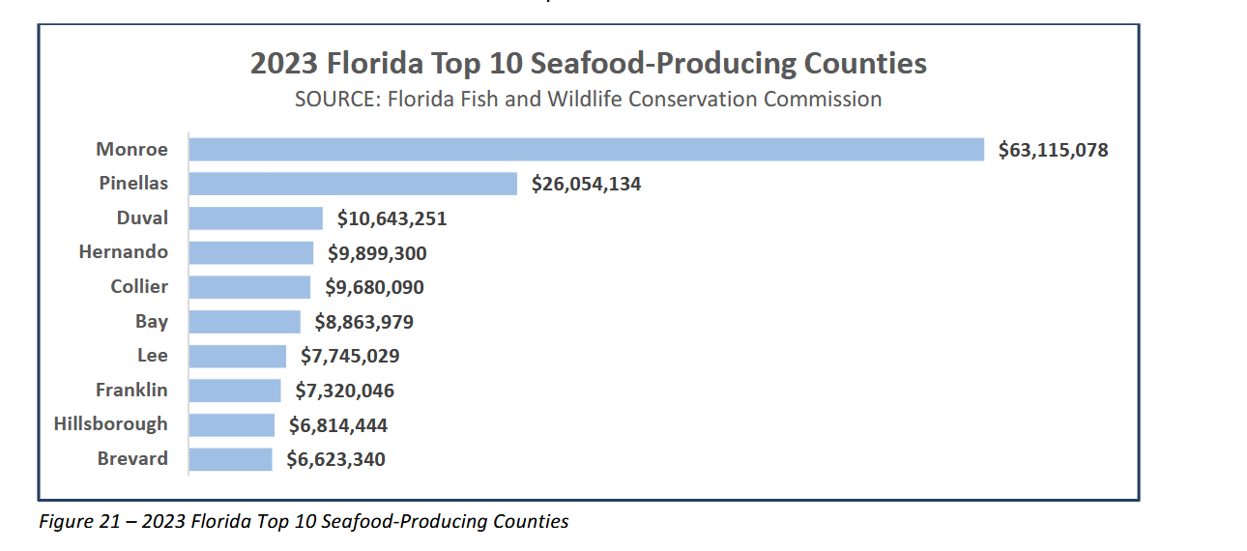
Fishing Workers
Demographic Reports
1,745 low-income fishing worker households; 140 fishing worker set-aside units
ACS household data does not allow county-level housing estimates, but Florida Fish and Wildlife Conservation Commission publishes data on seafood production:
Source: Florida Department of Agriculture and Consumer Services, 2024 Florida Seafood Report, https://ccmedia.fdacs.gov/content/download/110962/file/2024-seafood-report.pdf

Slide 27
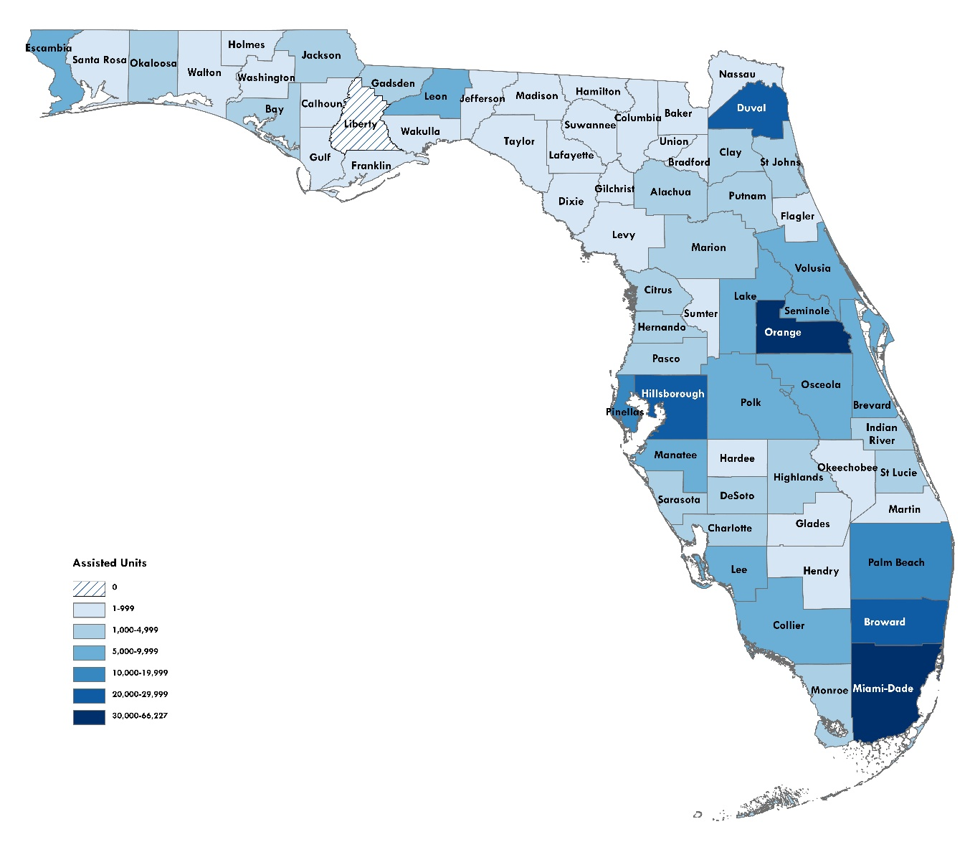
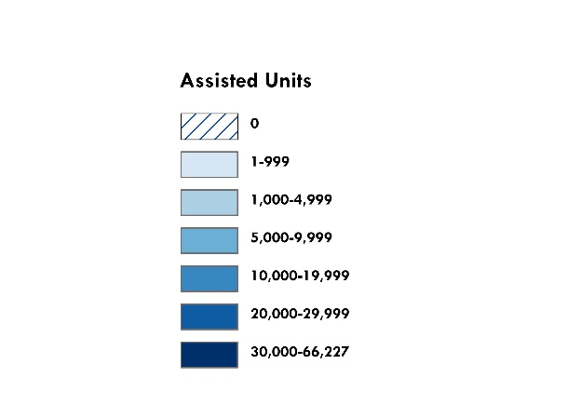
Assisted Housing Inventory
Assisted & Public Housing
Florida Housing, HUD multifamily, public housing, USDA RD, LHFAs
3,114 developments, 314,200 assisted units
Of these, Florida Housing funded 2,079 developments, 240,525 assisted units
Assisted Housing Units by County, 2025
Source: Shimberg Center for Housing Studies, Assisted Housing Inventory

Slide 28
Tenant Characteristics: Income
Assisted & Public Housing
Average Annual Household Income
Sources: Shimberg Center for Housing Studies, Assisted Housing Inventory and U.S. Census Bureau, 2023 American Community Survey

Slide 29
Tenant Characteristics: Rent
Assisted & Public Housing
Average Tenant-Paid Gross Rent (Rent + Utilities)
Sources: Shimberg Center for Housing Studies, Assisted Housing Inventory and U.S. Census Bureau, 2023 American Community Survey

Slide 30
Preservation Risks & Lost Properties
Assisted & Public Housing
Previous Rental Market Studies flagged loss of units starting in 2020 due to expiring 30-year LIHTC properties
2022-2025: 24 developments with 2,481 assisted units exited inventory due to expirations. Overlapping counts:
Florida Housing: 10 developments, 1,198 units
HUD: 7 developments, 709 units
RD: 2 developments, 65 units
Local Housing Finance Authorities: 6 developments, 829 units

Slide 31
Preservation Risks & Lost Properties
Assisted & Public Housing
By 2034, 250 developments/24,639 affordable units face similar expiration risks.
Largest group is 30-year expiring Florida Housing units:
196 developments/19,946 units
More than ¼ (5,751units) are in the 4-county Orlando metro area
Other heavily affected counties: Miami-Dade (2,487 units), Palm Beach (1,732 units), and Hillsborough (1,520 units)
Florida Housing’s investments have been critical in reducing expiration risk:
50-year affordability periods, including layering SAIL with 4% Credits
Extending affordability for early properties through additional 4% Credits
Preservation of project-based rental assistance and public housing

Slide 32
Preservation Risks: Expiring Subsidies
Assisted & Public Housing
Florida Housing Units by Expiration Year and Program Type, 2024-2034
Sources: Shimberg Center for Housing Studies, Assisted Housing Inventory

Slide 33
Preservation Risks: Aging Assisted & Public Housing
Assisted & Public Housing
936 developments with 67,694 units are at least 30 years old
Disproportionately HUD/USDA/Public Housing, elder-serving
Starting to include Florida Housing developments with extended affordability
860 developments with 113,130 units are 15-29 years old
Mostly Florida Housing, family properties

Slide 34
Florida Housing’s Role in Preservation
Assisted & Public Housing
Focus on housing with deep rental assistance from HUD, RD, Public Housing
276 properties, 30,220 units
Housing Credits, SAIL, and Bonds used to recapitalize older buildings and for public housing RAD replacement
Preserved units target lower incomes, more seniors compared to other Florida Housing units
Forthcoming report to look at Florida Housing’s reinvestment in own portfolio, particularly through 4% credits

Slide 35
Contact
Contact: Anne Ray
352-273-1192  aray@ufl.edu
Main site: http://www.shimberg.ufl.edu
Data clearinghouse: http://flhousing.data.shimberg.ufl.edu

